Slide 1
Empowering early-career researchers to enhance research culture with ReproducibiliTea
Dr William Ngiam
Lecturer at the University of Adelaide
Rigor and Reproducibility Seminar Series, University of Florida
31st October 2024

Slide 2
Who am I?
Lecturer in the School of Psychology at the University of Adelaide
I study visual attention and working memory – how we represent information in the mind and brain
We can focus on surprisingly little – attention is a precious resource, and so we need to be attending to the right things!
An active advocate for early-career researchers and Open Science
A contributor, as an early-career researcher myself; throughout my postdoc until now
I think a lot is at stake
I worry about an anti-science society – one where scientific research is no longer considered credible
I think the Open Science movement has a major role in ensuring science continues to have a positive impact on society

Slide 3
My goal for this talk is to inspire you to take action and improve science
Provide an overview of the reproducibility crisis (from the lens of psychological science)
Summarise the reforms that have to be introduced by the Open Science movement
Share my journey and perhaps convince you to pursue open and transparent science

Slide 4
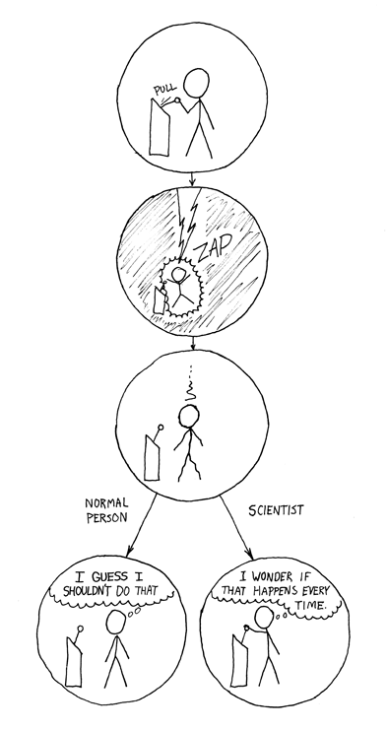

How does science work?
Is this how we actually do science?
Comic from https://xkcd.com/242/
Notes:
And thinking back to learning science in high school, when doing a chemistry or physics lab experiment, you're often instructed to repeat the experiment a few times and to find out if you observe the same results every time! And I had thought that repeating and replications was commonplace in science but to my surprise, it wasn't very clearly the case!

Slide 5
The reproducibility crisis
Also known as the replicability crisis
Sometimes the generalizability crisis, or the methodological crisis
The current collective concern that many scientific studies are difficult to reproduce or do not replicate
The psychological sciences (and biomedical sciences) have high-profile controversies at the start of the 2010s
There have been concerns about the lack of replications in the past!
e.g. Paul Meehl, Jacob Cohen and others were sounding the alarm in the 1970s
Romero, F. (2019). Philosophy of science and the replicability crisis. Philosophy Compass, 14(11), e12633.
Notes:
I want to note that there have been replication concerns in the past, throughout the history of science. But this time, the concern was widespread, received a lot of media attention (thanks to the advent of the internet) and seems to have caused some change! I also want to note that this is a current issue - this reproducibility crisis started around 2010, if you remember the surprising study by Daryl Bem on ESP or precognition that YC mentioned last week.

Slide 6
Notable examples of failed replications
Priming people with elderly stereotypes leads to slower walking (Bargh, 1996) (almost 6000 citations!)
Multiple failures to replicate
Recent evidence suggesting that any walking speed effect was due to experimenters’ expectations of what would happen
Daryl Bem, a well-known and respected social psychologist and professor at the time, publishes positive evidence for precognition and premonition
9 experiments, 1000 participants
Standard statistical analyses
Published in the Journal of Personality and Social Psychology (a highly prestigious journal) after peer review!
A pre-registered replication failed to find any of the reported effects in three attempts (Ritchie, Wiseman and French, 2012)
Bargh, J. A., Chen, M., & Burrows, L. (1996). Automaticity of social behavior: Direct effects of trait construct and stereotype activation on action. Journal of personality and social psychology, 71(2), 230.
Bem, D. J. (2011). Feeling the future: experimental evidence for anomalous retroactive influences on cognition and affect. Journal of personality and social psychology, 100(3), 407.
Ritchie, S. J., Wiseman, R., & French, C. C. (2012). Failing the future: Three unsuccessful attempts to replicate Bem's ‘Retroactive Facilitation of Recall’ Effect. PloS one, 7(3).
https://www.theguardian.com/science/2012/mar/15/precognition-studies-curse-failed-replications

Slide 7
Notable examples of failed replications
People with refillable soup bowls ate 73% more soup unknowingly! (Wansink, Painter and North, 2005)
Dubious that this study ever happened (Heathers, 2018)
Wansink has 18 retracted papers, 7 expressions of concern, 15 corrections
Ego depletion – using up self-control resources on one task leads to hindered self-control on other tasks
A large-scale multi-lab replication attempt found no effect. (Vohs et al., 2021)
Diederik Stapel, a former professor of social psychology, is found to have faked data in numerous research findings after young researchers examine his data
Currently at 58 retractions – 8th most retractions on the Retraction Watch Leaderboard
Wansink, B., Painter, J. E., & North, J. (2005). Bottomless bowls: why visual cues of portion size may influence intake. Obesity research, 13(1), 93-100. Heathers, J. (2018). https://jamesheathers.medium.com/sprite-case-study-5-sunset-for-souper-man-ee898b6af9f5 Vohs, K., Schmeichel, B., Lohmann, S., Gronau, Q. F., Finley, A. J., Wagenmakers, E. J., & Albarracín, D. (2021). A multi-site preregistered paradigmatic test of the ego depletion effect.
Retraction Watch Leaderboard: https://retractionwatch.com/the-retraction-watch-leaderboard/

Slide 8
Failures to replicate in psychology
39% of studies (36 of 97 that had positive findings) published in high-ranking psychology journals replicated (Reproducibility Project: Psychology; Open Science Collaboration, 2015)
14 of 28 psychology findings replicated with massive sample sizes (Many Labs 2; Klein, 2018)
3 of 10 psychology findings replicated across many participant pools (Many Labs 3; Ebersole et al., 2016)
13 of 21 social science experiments in Nature and Science between 2010 and 2015 replicated (Camerer, et al., 2018)
Open Science Collaboration. (2015). Reproducibility Project: Psychology. OSF. doi:10.17605/OSF.IO/EZCUJ
Klein, R. A., Vianello, M., Hasselman, F., Adams, B. G., Adams Jr, R. B., Alper, S., ... & Batra, R. (2018). Many Labs 2: Investigating variation in replicability across samples and settings. Advances in Methods and Practices in Psychological Science, 1(4), 443-490 Ebersole, C. R., Atherton, O. E., PhD, Belanger, A. L., Skulborstad, H. M., Allen, J., Banks, J. B., … Nosek, B. A. (2016, August 17). Many Labs 3: Evaluating participant pool quality across the academic semester via replication. https://doi.org/10.31234/osf.io/q4emc. Camerer, C. F., Dreber, A., Holzmeister, F., Ho, T. H., Huber, J., Johannesson, M., ... & Wu, H. (2018). Evaluating the replicability of social science experiments in Nature and Science between 2010 and 2015. Nature Human Behaviour, 2(9), 637-644.
Notes:
There have been many notable large-scale replication efforts that capture the replication crisis in psychology. The most well-known is the Reproducibility Project: Psychology, which set about directly replicating 100 published findings in high-ranking psychology journals. Out of 100, only 39% replicated (36 out of the 97 that had positive findings). That's a surprisingly low number - especially if you consider that approximately only 5% of findings should be false positives given the statistical significance level of p-values is set at 0.05. I also want to mention that the effects that DO replicate, often had lower reported effect sizes. This is pretty important, say in terms of an applied behavioral intervention, if an effect isn't as strong as expected.
In other replication efforts, some known as ManyLabs projects, we see similar proportion of failed replications. With extremely large sample sizes, ensuring the studies were adequately well-powered, only 14 of 28 findings were replicated. In ManyLabs 3, only 3 of the 10 findings replicated across the various participant pools in the project. And even in the highly prestigious journals, Nature and Science, only 13 of 21 findings were replicated (despite the likely high impact of these findings and papers considering the venue they were published in).

Slide 9
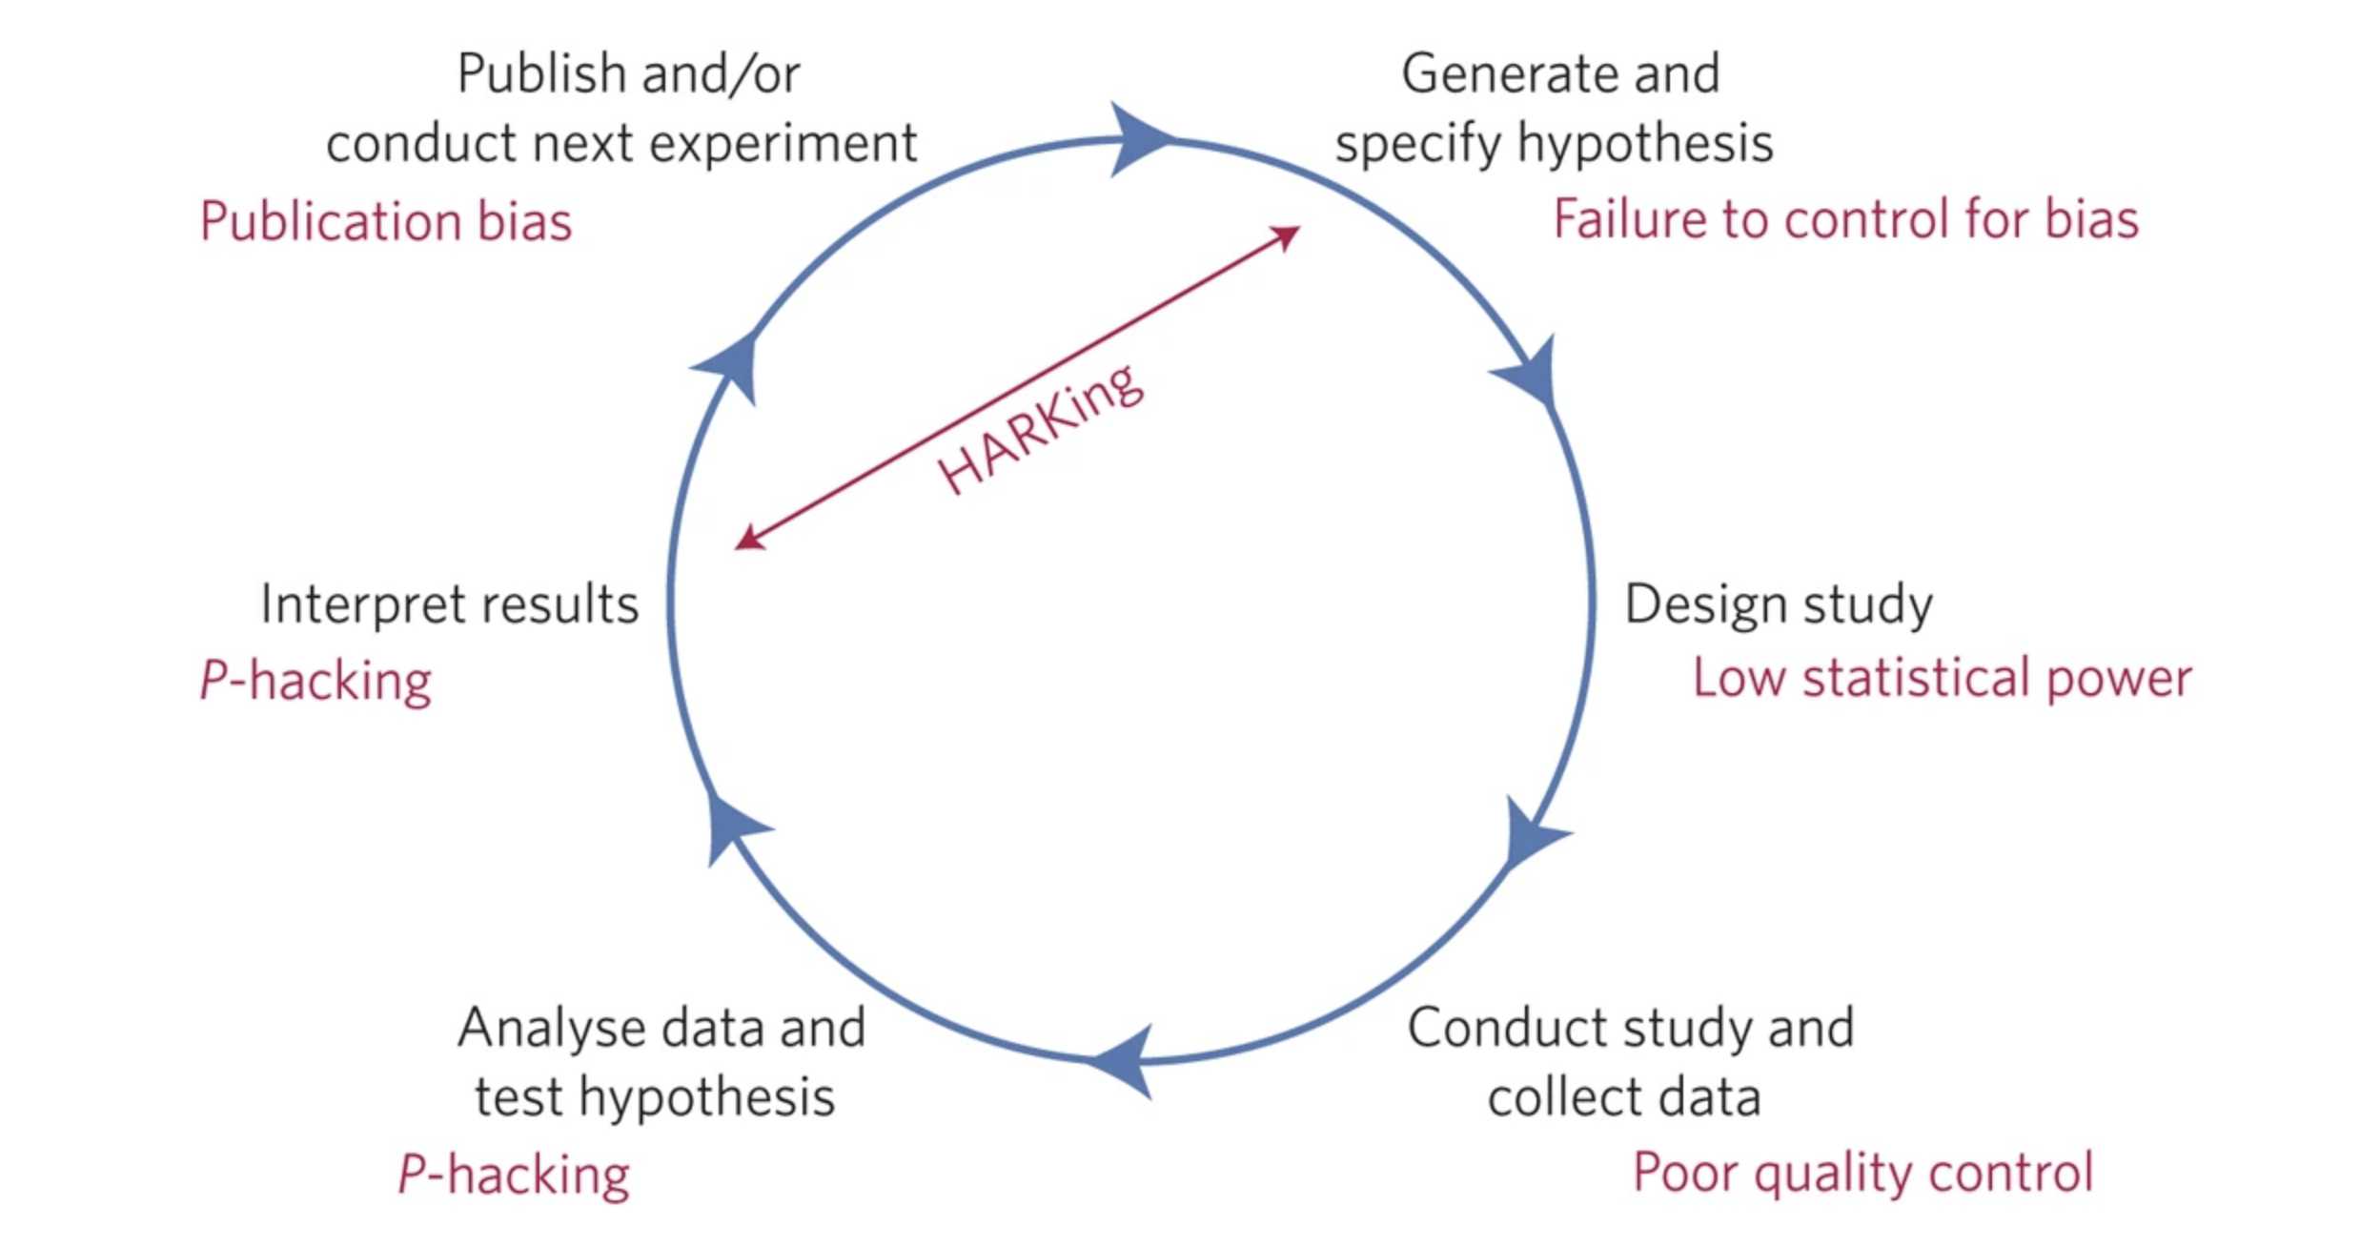
Threats to reproducible science
Munafò, M. R., Nosek, B. A., Bishop, D. V., Button, K. S., Chambers, C. D., Du Sert, N. P., ... & Ioannidis, J. P. (2017). A manifesto for reproducible science. Nature human behaviour, 1(1), 1-9.

Slide 10
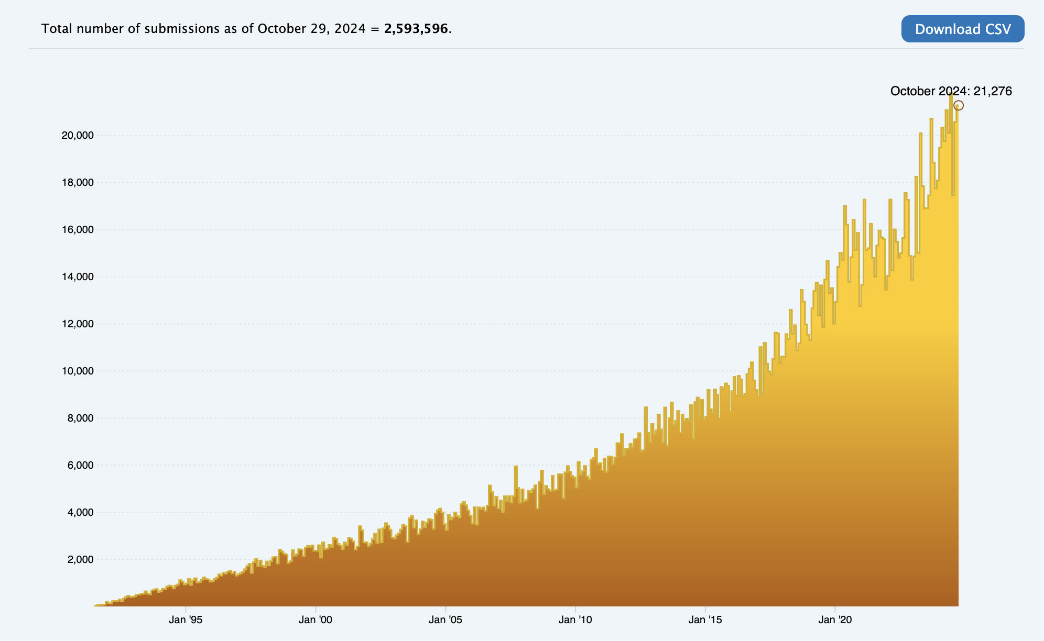
Exponential growth of scientific publications
How many scientific articles are published each year?
Figure taken from arxiv.org on the number of submissions over time. https://arxiv.org/stats/monthly_submissions

Slide 11
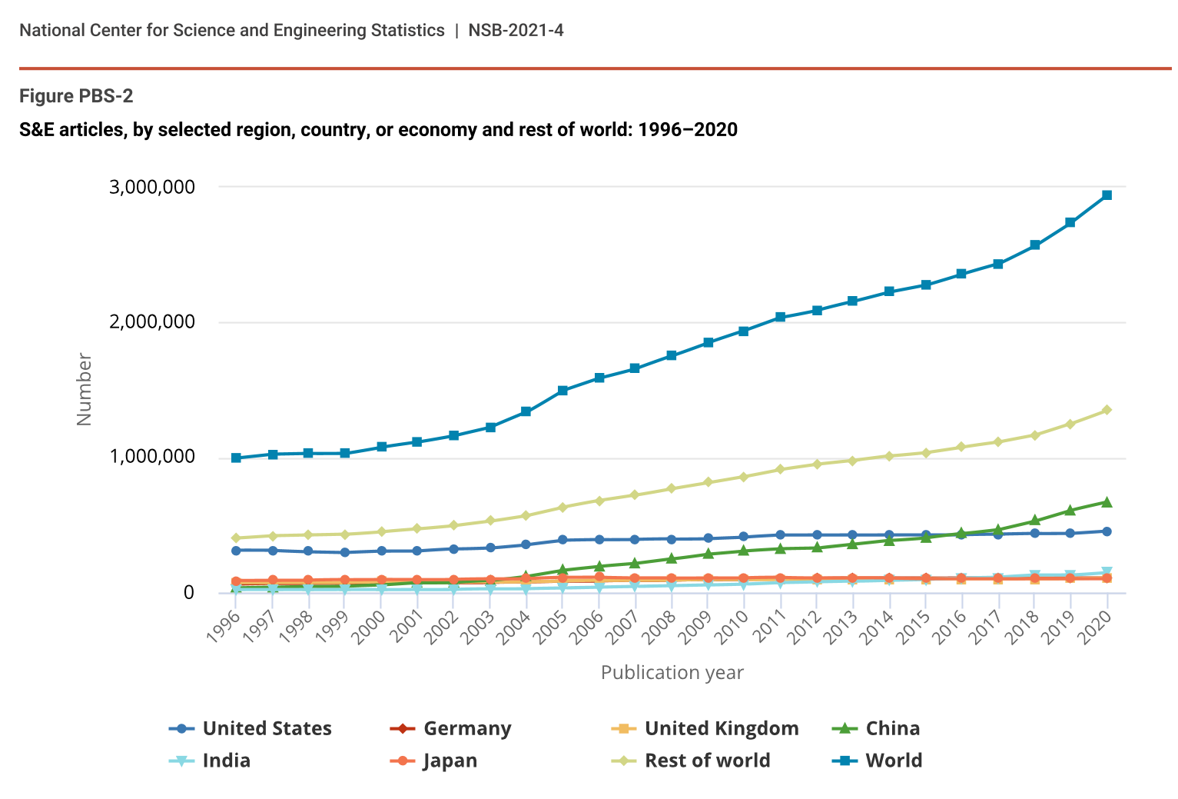
Exponential growth of scientific publications
Estimated to have reached 2.9 million articles in 2020 (National Science Board, National Science Foundation)
Increasing by approximately 4% each year (Pan, Petersen, Pammolli and Fortunato, 2016)
Review by National Center for Science and Engineering Statistics. https://ncses.nsf.gov/pubs/nsb20214/publication-output-by-country-region-or-economy-and-scientific-field
Pan, R. K., Petersen, A. M., Pammolli, F., & Fortunato, S. (2018). The memory of science: Inflation, myopia, and the knowledge network. Journal of Informetrics, 12(3), 656-678. https://arxiv.org/abs/1607.05606

Slide 12
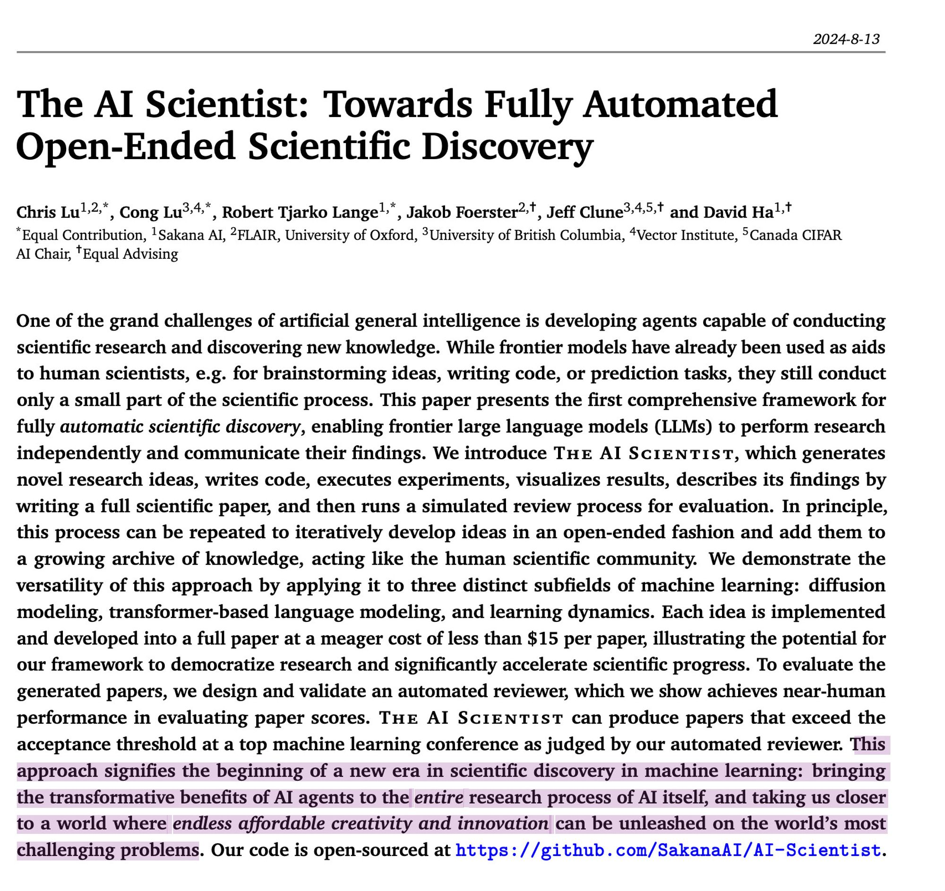

Is the goal of science just to publish?
My impression is that their attention is misplaced on the incentives, and lacks a considered philosophy of science.
Does producing more papers lead to more knowledge? Solutions to world’s problems? Progress in society?
via Carl Bergstrom, evolutionary biologist (@carlbergstrom.com on BlueSky) https://bsky.app/profile/carlbergstrom.com/post/3kzmxr3a2wz2a

Slide 13
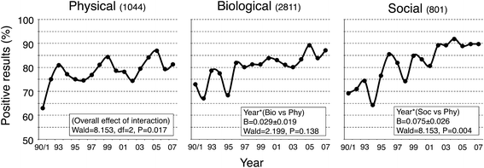
The decline of negative results
The proportion of papers reporting a positive result has been increasing from ~70% in 1990 to ~90% by 2005 (Fanelli, 2012)
In the recent psychology literature, this proportion is estimated to be ~95% (Scheel, Schijen and Lakens, 2021)
Does having more papers (mostly with positive findings) mean faster scientific progress?
I say not really.
Figure from Fanelli, D. (2012). Negative results are disappearing from most disciplines and countries. Scientometrics, 90(3), 891-904. Scheel, A. M., Schijen, M. R., & Lakens, D. (2021). An excess of positive results: Comparing the standard Psychology literature with Registered Reports. Advances in Methods and Practices in Psychological Science, 4(2), 25152459211007467.

Slide 14
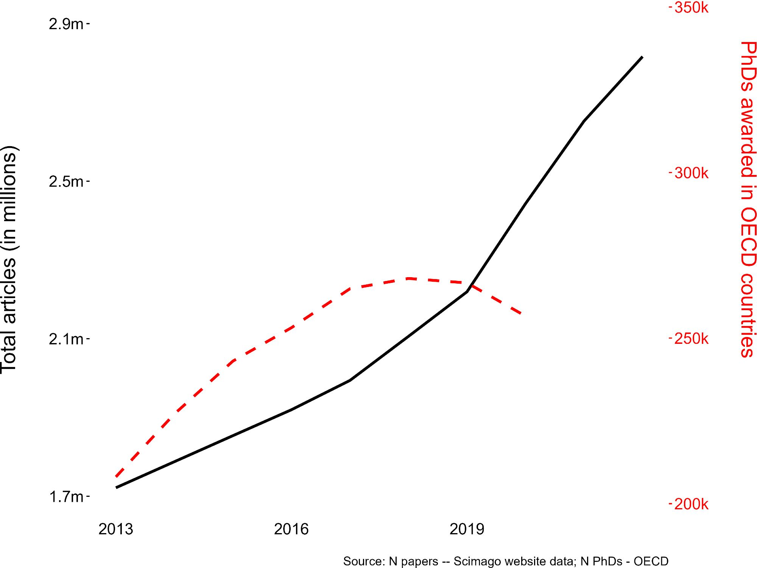
Increasing strain on scientists to read, review and co-ordinate.
Magnifying an “attention economy” where scientists compete for their work to be noticed and have impact.
Figure copied from https://bsky.app/profile/hansonmark.bsky.social/post/3kajeqzv3nt2b
Hanson, Barreiro, Crosetto and Brockington (2023). The strain on scientific publishing. ArXiv. https://arxiv.org/abs/2309.15884

Slide 15
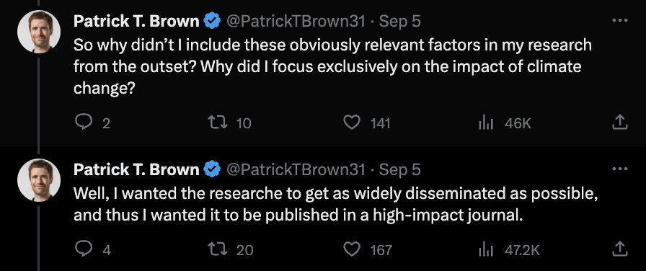
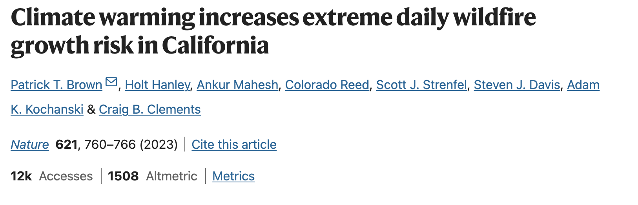
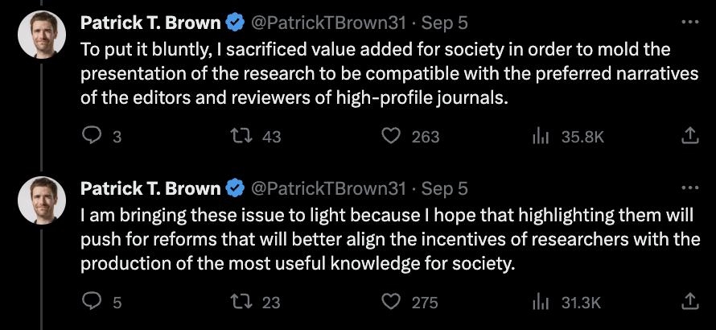
What comes at the cost of scientific rigor
Is this appropriate scientific communication?
Screenshots from https://twitter.com/PatrickTBrown31/status/1699016555844035045

Slide 16
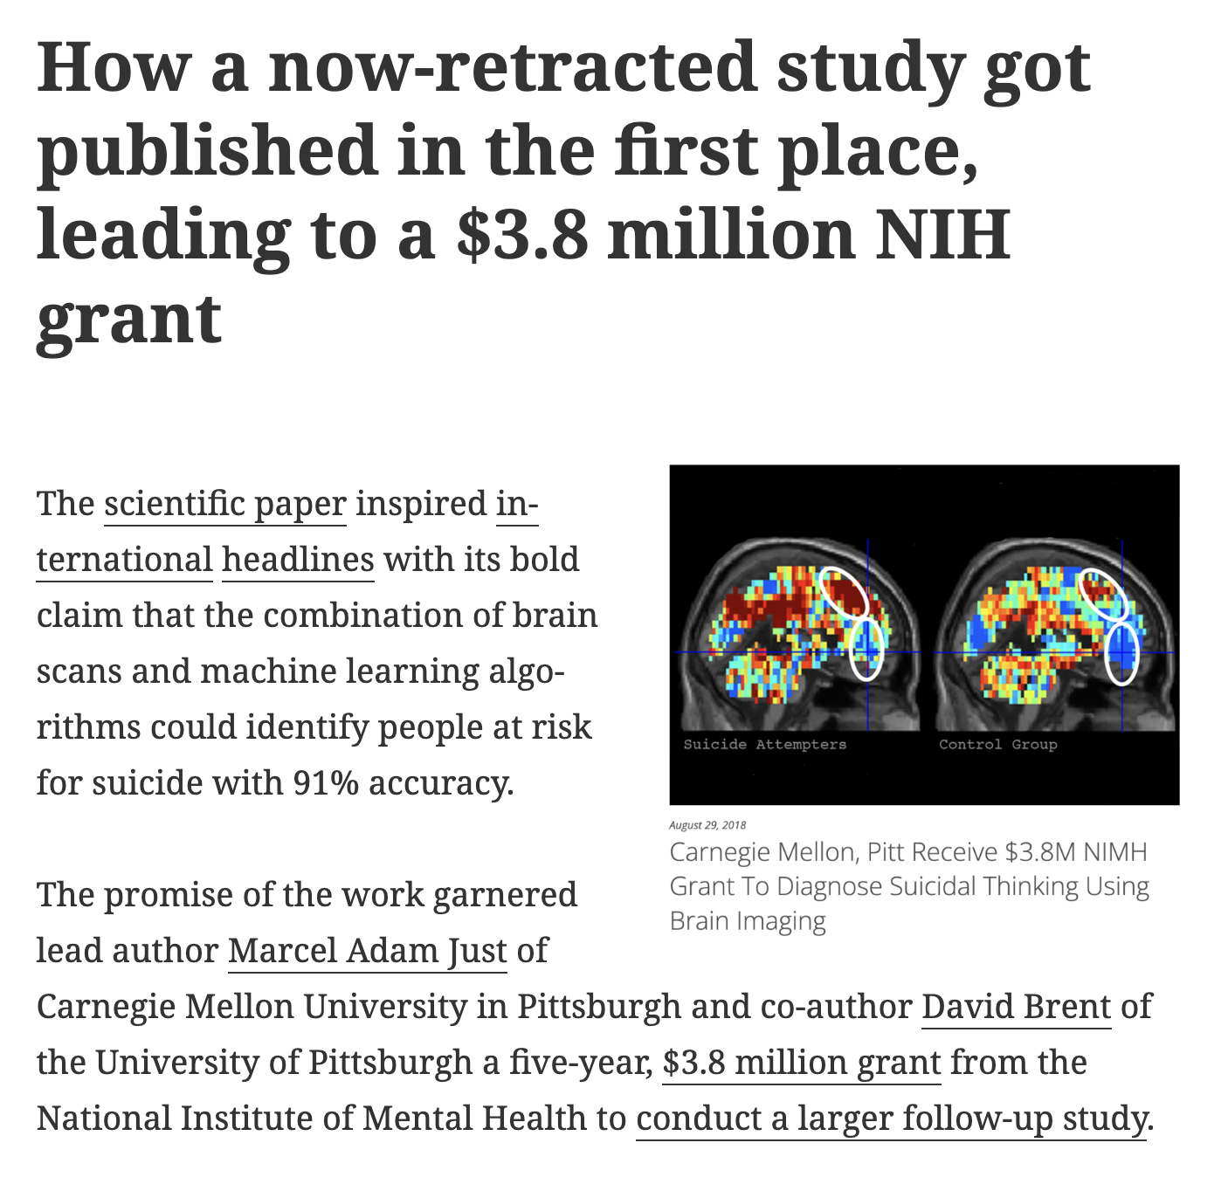
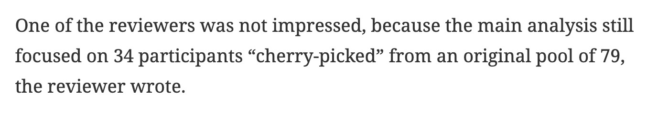
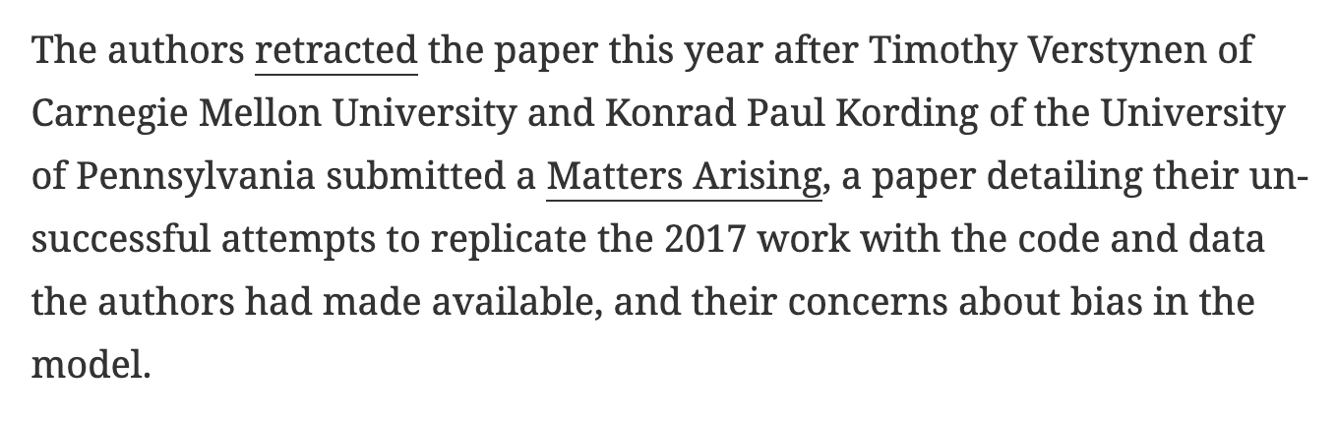
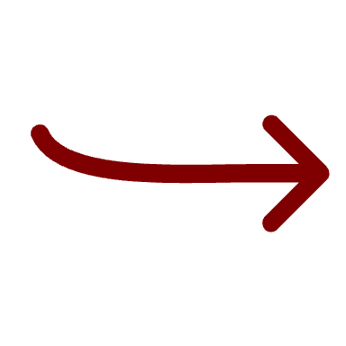
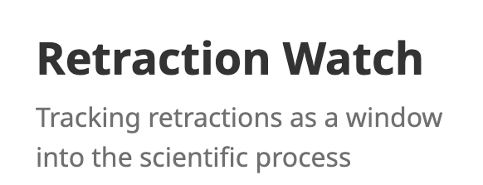
This was received by Nature in September 2020, and published on 6th April, 2023 with retraction of the original article 6 years later.
https://retractionwatch.com/2023/06/09/how-a-now-retracted-study-got-published-in-the-first-place-leading-to-a-3-8-million-nih-grant/ Verstynen, T., & Kording, K. P. (2023). Overfitting to ‘predict’ suicidal ideation. Nature Human Behaviour, 7(5), 680-681.

Slide 17
Comic from https://xkcd.com/242/

Slide 18
How often do direct replications occur in psychology?
0.2%
(169 out of 82,775 articles)
Figure given by Beth Clarke in a talk titled “The prevalence of replications in psychology”, given at the Metascience 2023 conference. https://www.youtube.com/watch?v=teOvjoJbmvM

Slide 19
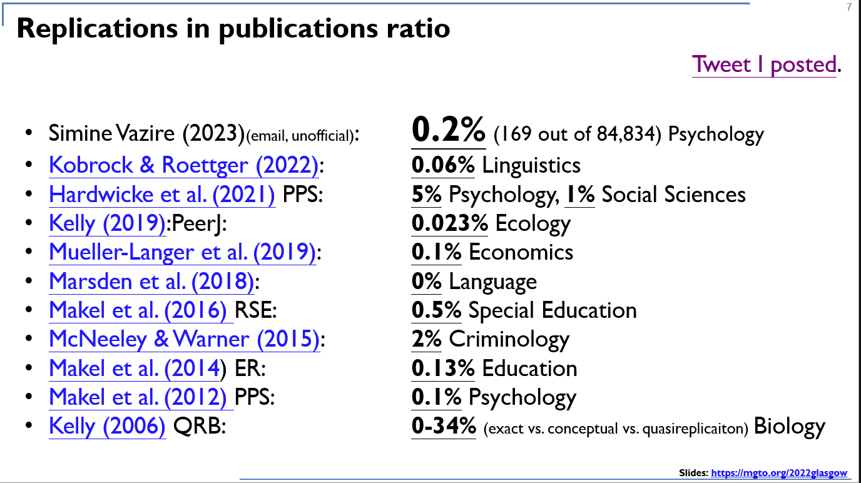
Not enough.
Slide by Gilad Feldman. Taken from https://twitter.com/giladfeldman/status/1662887769822068738/photo/1

Slide 20
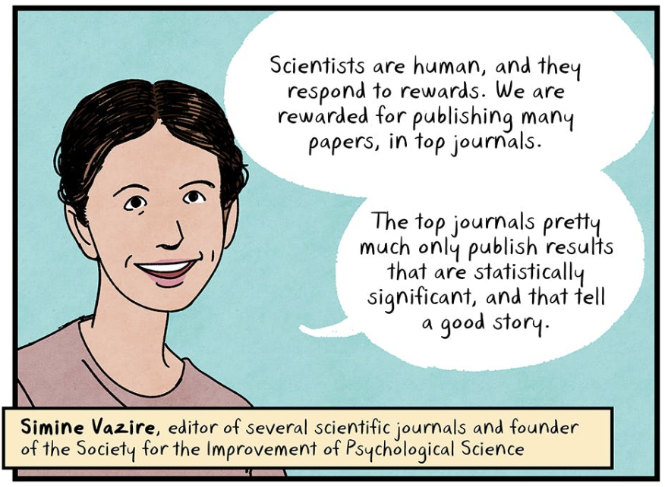
Current academic structures have lead to more papers, but with incentives and research assessment being broken, it has not meant more rigorous science.
Taken from Repeat After Me by Maki Naro. Published by The Nib. https://thenib.com/repeat-after-me/

Slide 21
Is science self-correcting?
Psychology researchers realize that decisions made on statistical analysis can introduce bias and increase the likelihood of false positives
Large-scale replication efforts fail to replicate most published findings
When an effect is replicated, the effect size is typically smaller then reported
Scientists work within structures that incentivize producing research articles – leading to an increasing rate of article production
Research quality and rigor appears to be diminished, leading to more research issues and dampening positive impact on society

Slide 22
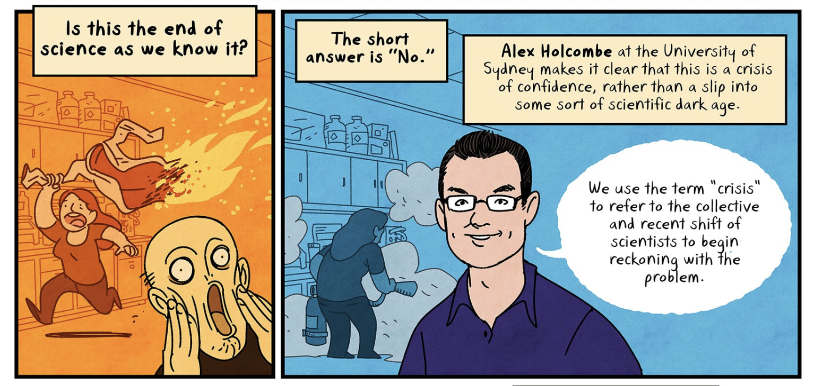
Taken from Repeat After Me by Maki Naro. Published by The Nib. https://thenib.com/repeat-after-me/

Slide 23
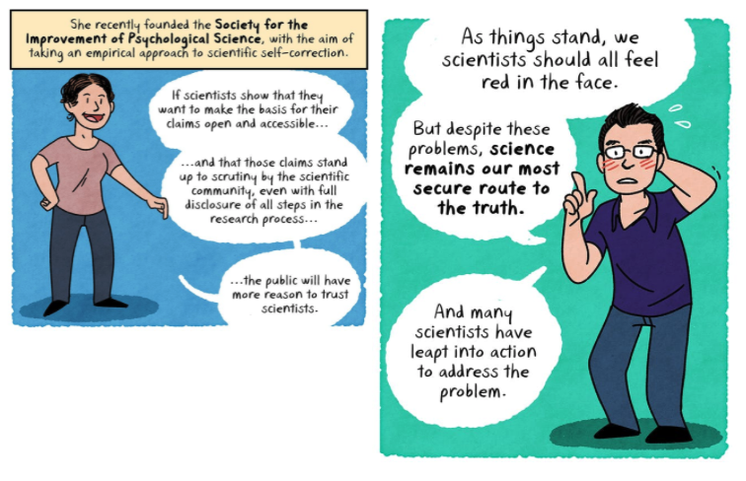
The credibility revolution
In the words of Simine Vazire, founder of the Society for Improvement of Psychological Science:
A “crisis implies we are at a loss for solutions, when in fact we have identified many ways to improve science’s credibility.”
Many scientists are actively working on solving the current problems!
Vazire, S. (2018). Implications of the credibility revolution for productivity, creativity, and progress. Perspectives on Psychological Science, 13(4), 411-417.
Comic panel from Repeat After Me by Maki Naro from The Nib – https://www.thenib.com/repeat-after-me

Slide 24
The Open Science movement
“An umbrella term used to refer to the concepts of openness, transparency, rigor, reproducibility, replicability, and accumulation of knowledge, which are considered fundamental features of science” (Crüwell et al., 2018)
A rapidly growing and evolving movement that has had (and continues to have) a long-lasting effect on how science is being done!
Crüwell, S., van Doorn, J., Etz, A., Makel, M. C., Moshontz, H., Niebaum, J. C., Orben, A., Parsons, S., & Schulte-Mecklenbeck, M. (2018). 7 Easy Steps to Open Science: An Annotated Reading List. https://doi.org/10.31234/osf.io/cfzyx
Notes:
mention credibility revolution

Slide 25
Preregistration and Registered Reports
Preregistration involves publicly posting the research question, hypotheses, design, planned analysis before the data is collected (or examined)
Hosted on AsPredicted.org or Open Science Framework and others!
Brings transparency to the researchers’ design and analysis decisions, combating researcher bias, analytical flexibility and p-hacking
Registered Reports are a new publishing format where the study design is peer-reviewed and accepted in-principle (Chambers et al., 2015)
This combats publication bias – the notion that positive results are most worth publishing – and shifts focus to rigor and methodology away from the findings
Chambers, C. D., Dienes, Z., McIntosh, R. D., Rotshtein, P., & Willmes, K. (2015). Registered reports: realigning incentives in scientific publishing. Cortex, 66, A1-A2. For a glossary of Open Scholarship terms, see https://forrt.org/glossary by the Framework for Open and Reproducible Research Training

Slide 26
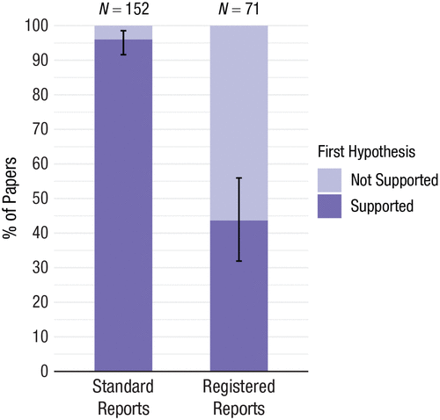
It is working!
Registered Reports have substantially fewer positive results than the standard literature (Scheel, Schijen and Lakens, 2021)
Likely due to a reduction in publication bias and error inflation!
Scheel, A. M., Schijen, M. R., & Lakens, D. (2021). An excess of positive results: Comparing the standard Psychology literature with Registered Reports. Advances in Methods and Practices in Psychological Science, 4(2), 25152459211007467.

Slide 27
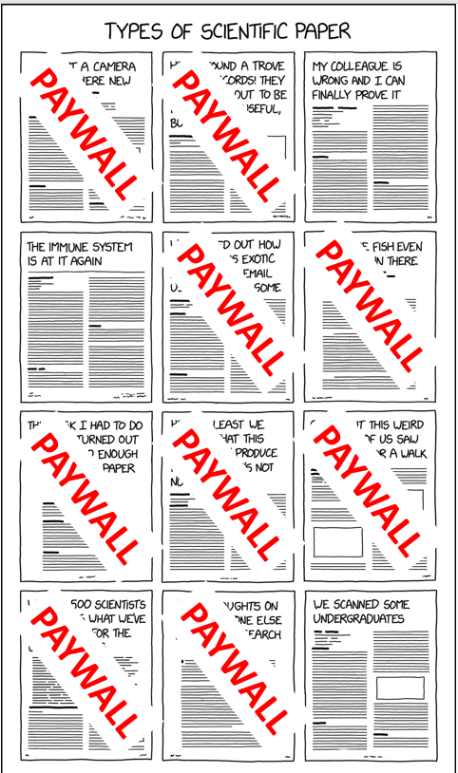
Open access to the knowledge
Scientific knowledge should be freely accessible to the public!
Comic by https://twitter.com/AndrewBarnas/status/1388161745684996098/photo/1 Original comic: https://xkcd.com/2456/

Slide 28
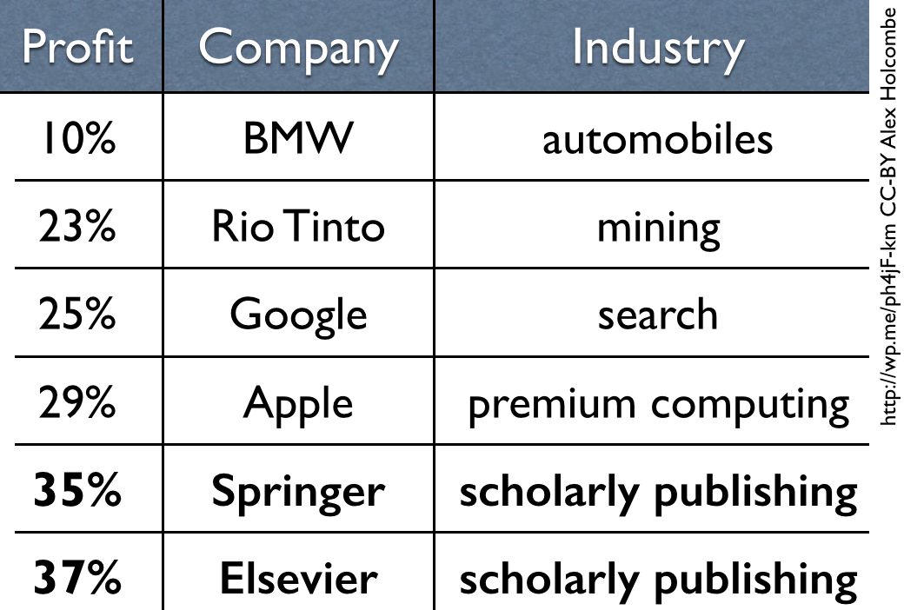
Profit margins of scientific publishing companies
Elsevier made an operating profit of £982 million in 2019, £1,021 million in 2020, £1,001 million in 2021, £1.3 billion in 2022, £1.79 billion in 2023, at an operating margin of ~31-37% according to their annual reports.
RELX Annual Report and Financial Statements accessed via https://www.relx.com/investors/annual-reports/2021
https://markets.ft.com/data/announce/detail?dockey=1323-16333416-4LUAGTEE271HMCQHV3723NQ9NR
Figure courtesy of Alex Holcombe’s blogpost “Scholarly publisher profit update” https://alexholcombe.wordpress.com/2015/05/21/scholarly-publisher-profit-update/.

Slide 29
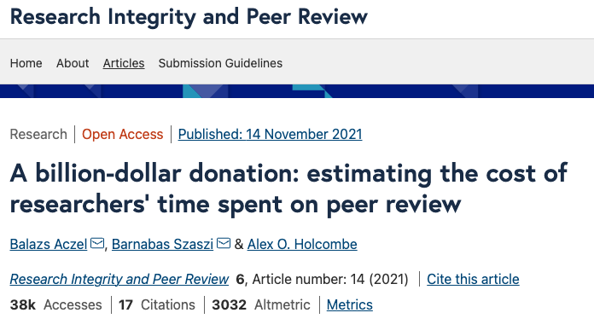
Aczel, B., Szaszi, B., & Holcombe, A. O. (2021). A billion-dollar donation: estimating the cost of researchers’ time spent on peer review. Research Integrity and Peer Review, 6(1), 1-8.

Slide 30
Open access publishing
Making scientific publicly accessible via preprints (PsyArXiv or bioRxiv) or publishing in (diamond) open access journals
McKiernan, E. C., Bourne, P. E., Brown, C. T., Buck, S., Kenall, A., Lin, J., ... & Yarkoni, T. (2016). Point of view: How open science helps researchers succeed. elife, 5, e16800.

Slide 31
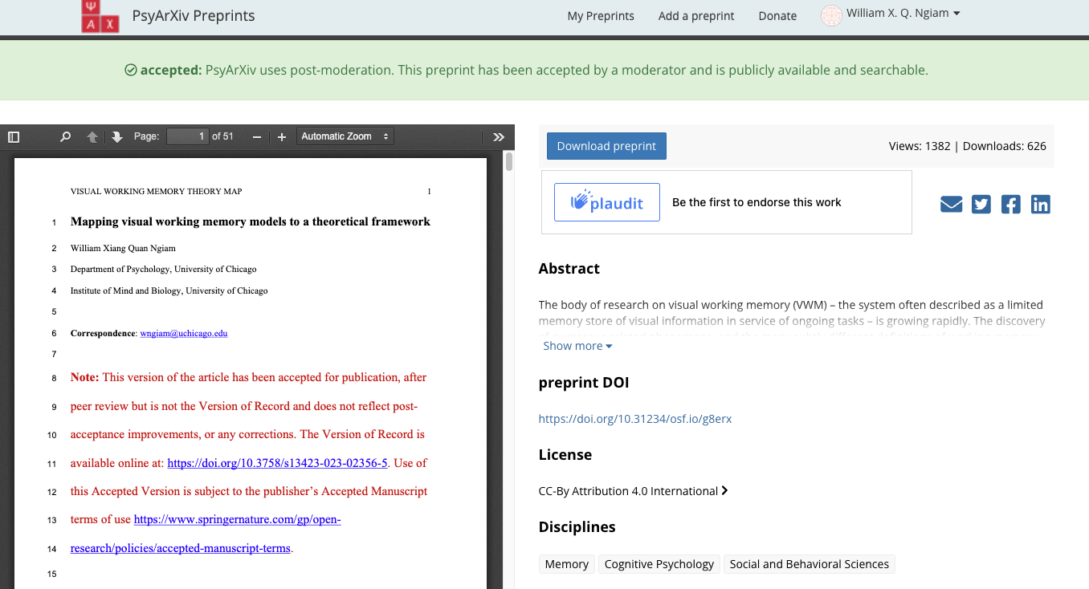

Slide 32
Open access publishing
Making scientific publicly accessible via preprints (PsyArXiv or bioRxiv) or publishing in (diamond) open access journals
Journals have article processing charges (APC) (charging the scientist!) to publish the paper for open access
USD$3710 for Cognitive Psychology, USD$3450 for NeuroImage
Receives more citations and coverage than non-OA research, likely due to increased ease of access and visibility (McKiernan et al., 2016)
Consider other content formats for sharing research that are likely more effective science communication!
Open access shifts power away from publishers
Creating open educational resources (e.g. how-to or explainer videos)
Writing informal blogposts
McKiernan, E. C., Bourne, P. E., Brown, C. T., Buck, S., Kenall, A., Lin, J., ... & Yarkoni, T. (2016). Point of view: How open science helps researchers succeed. elife, 5, e16800.

Slide 33
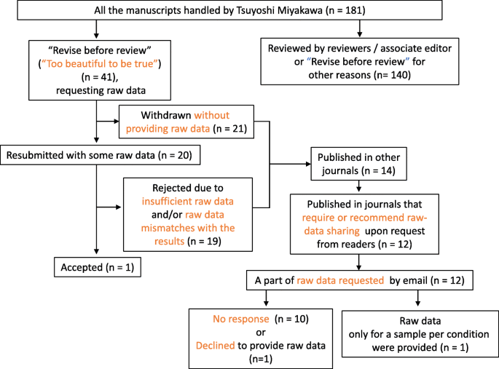
”Data available upon request”
Tsuyoshi Miyakawa, Editor-in-Chief at Molecular Brain, requested data for 41 submissions.
21 withdrew their submission
19 provided insufficient data or mismatches
14 published elsewhere -> raw data for received on request for 1
1 accepted
Some scientists are willing to game the journal system for publications…
Miyakawa, T. (2020). No raw data, no science: another possible source of the reproducibility crisis. Molecular brain, 13, 1-6. (Thanks to Toby Prike for passing this on!)

Slide 34
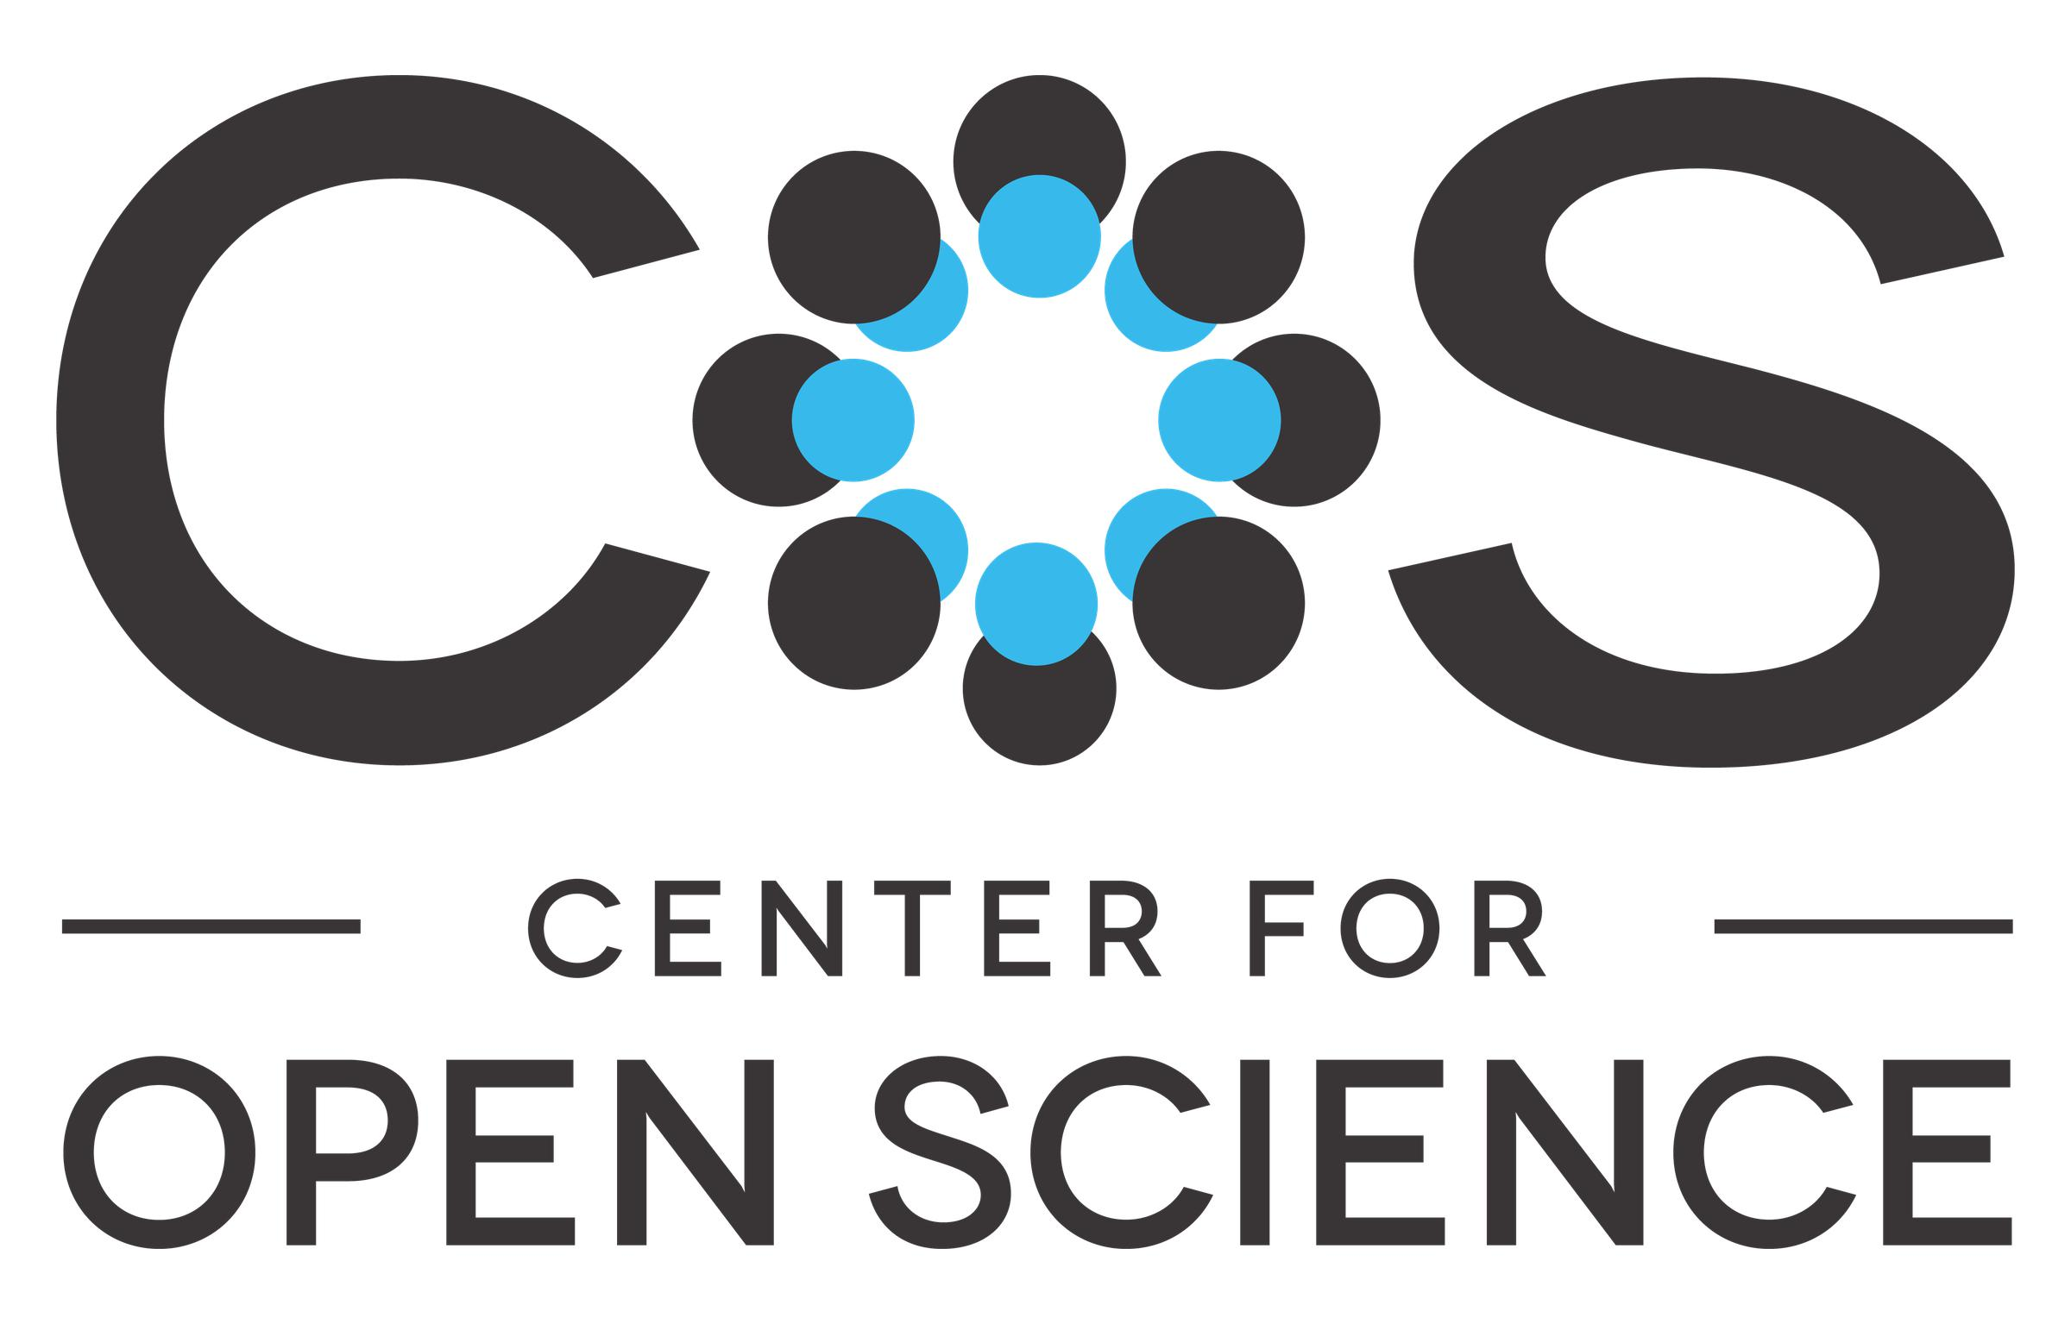

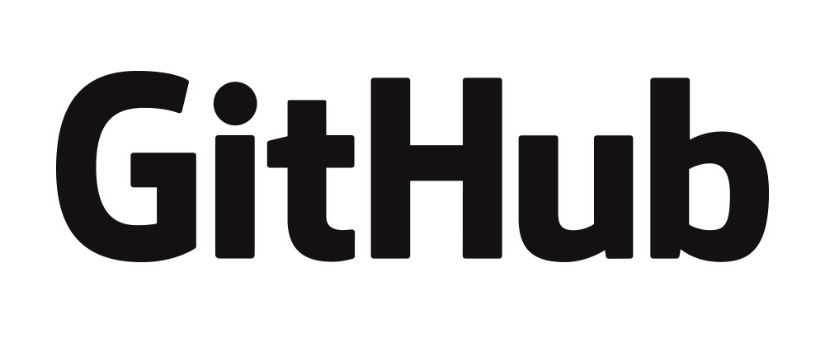
Open access to research materials
Sharing experimental code/data/stimuli for open access
Making a public repository of all research materials on the Open Science Framework (run by the Center for Open Science)
Uploading code and packages to GitHub and making it publicly available
Allows for in-depth scrutiny and evaluation
And allows for re-analysis of the data for other purposes!
Promotes equity as it can reduce barriers for other researchers!

Slide 35
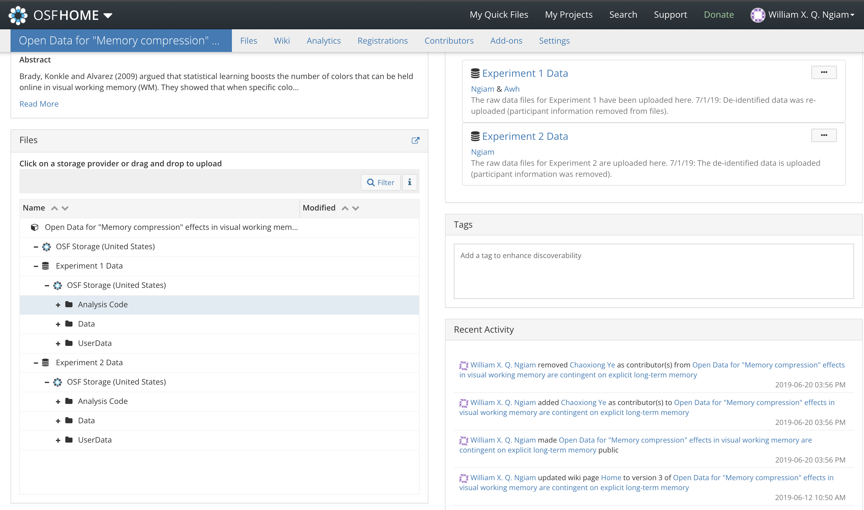

Slide 36
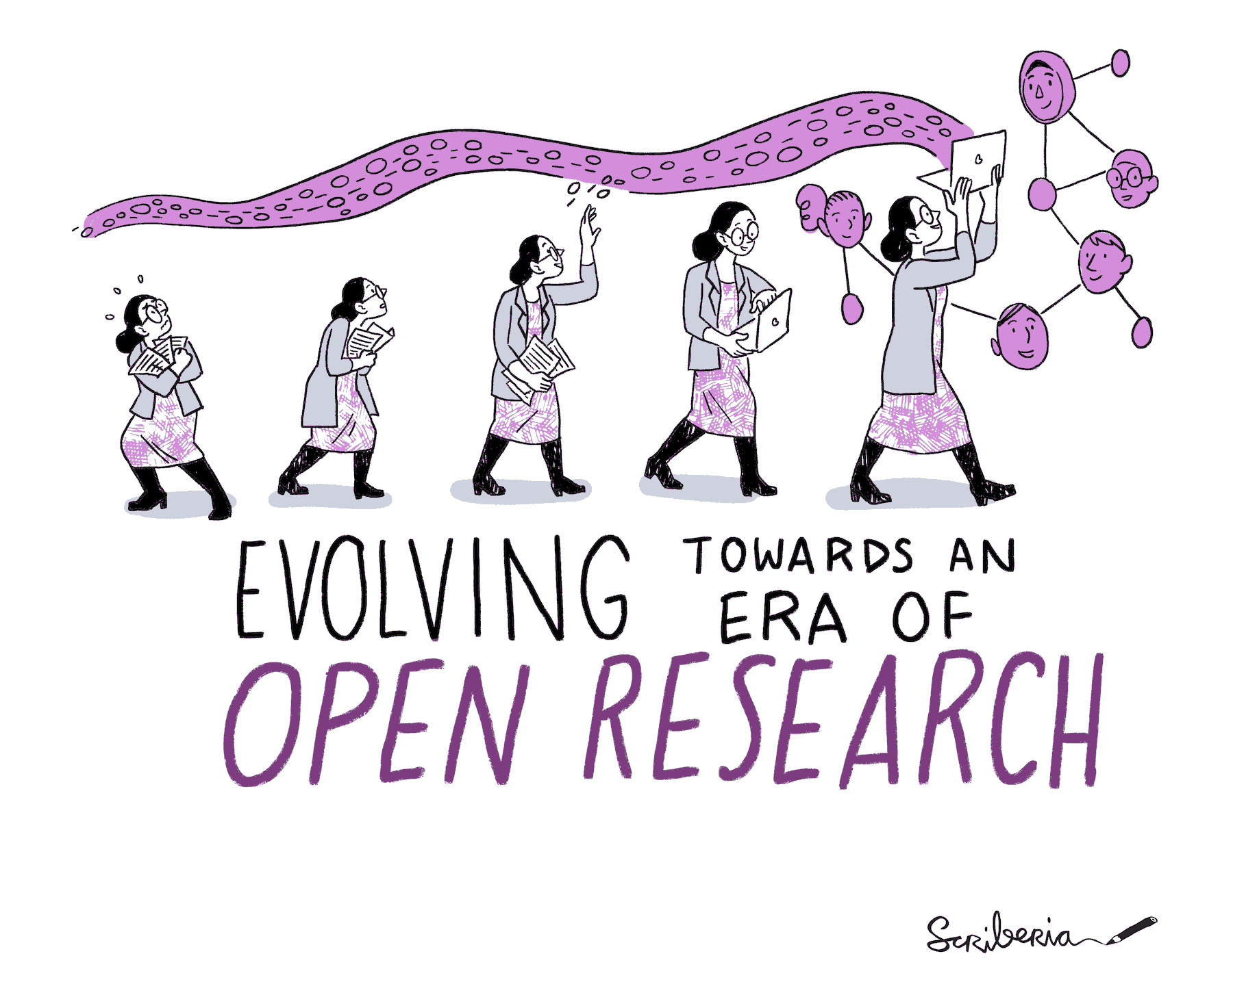
Research rigor needs to be a priority… and that starts with you.
The Turing Way project illustration by Scriberia.
Used under a CC-BY 4.0 licence. DOI: 10.5281/zenodo.3332807.

Slide 37
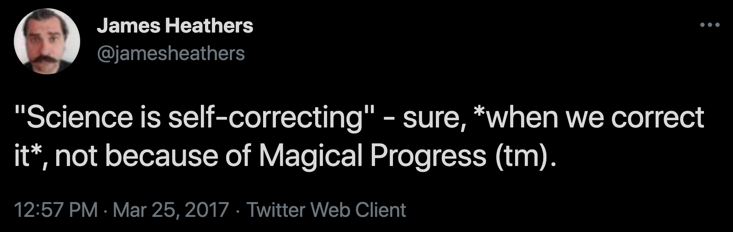
Not doing anything adds resistance to changes and reforms. It calcifies existing structures.

Slide 38
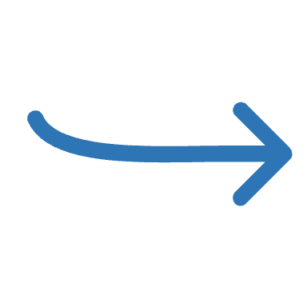
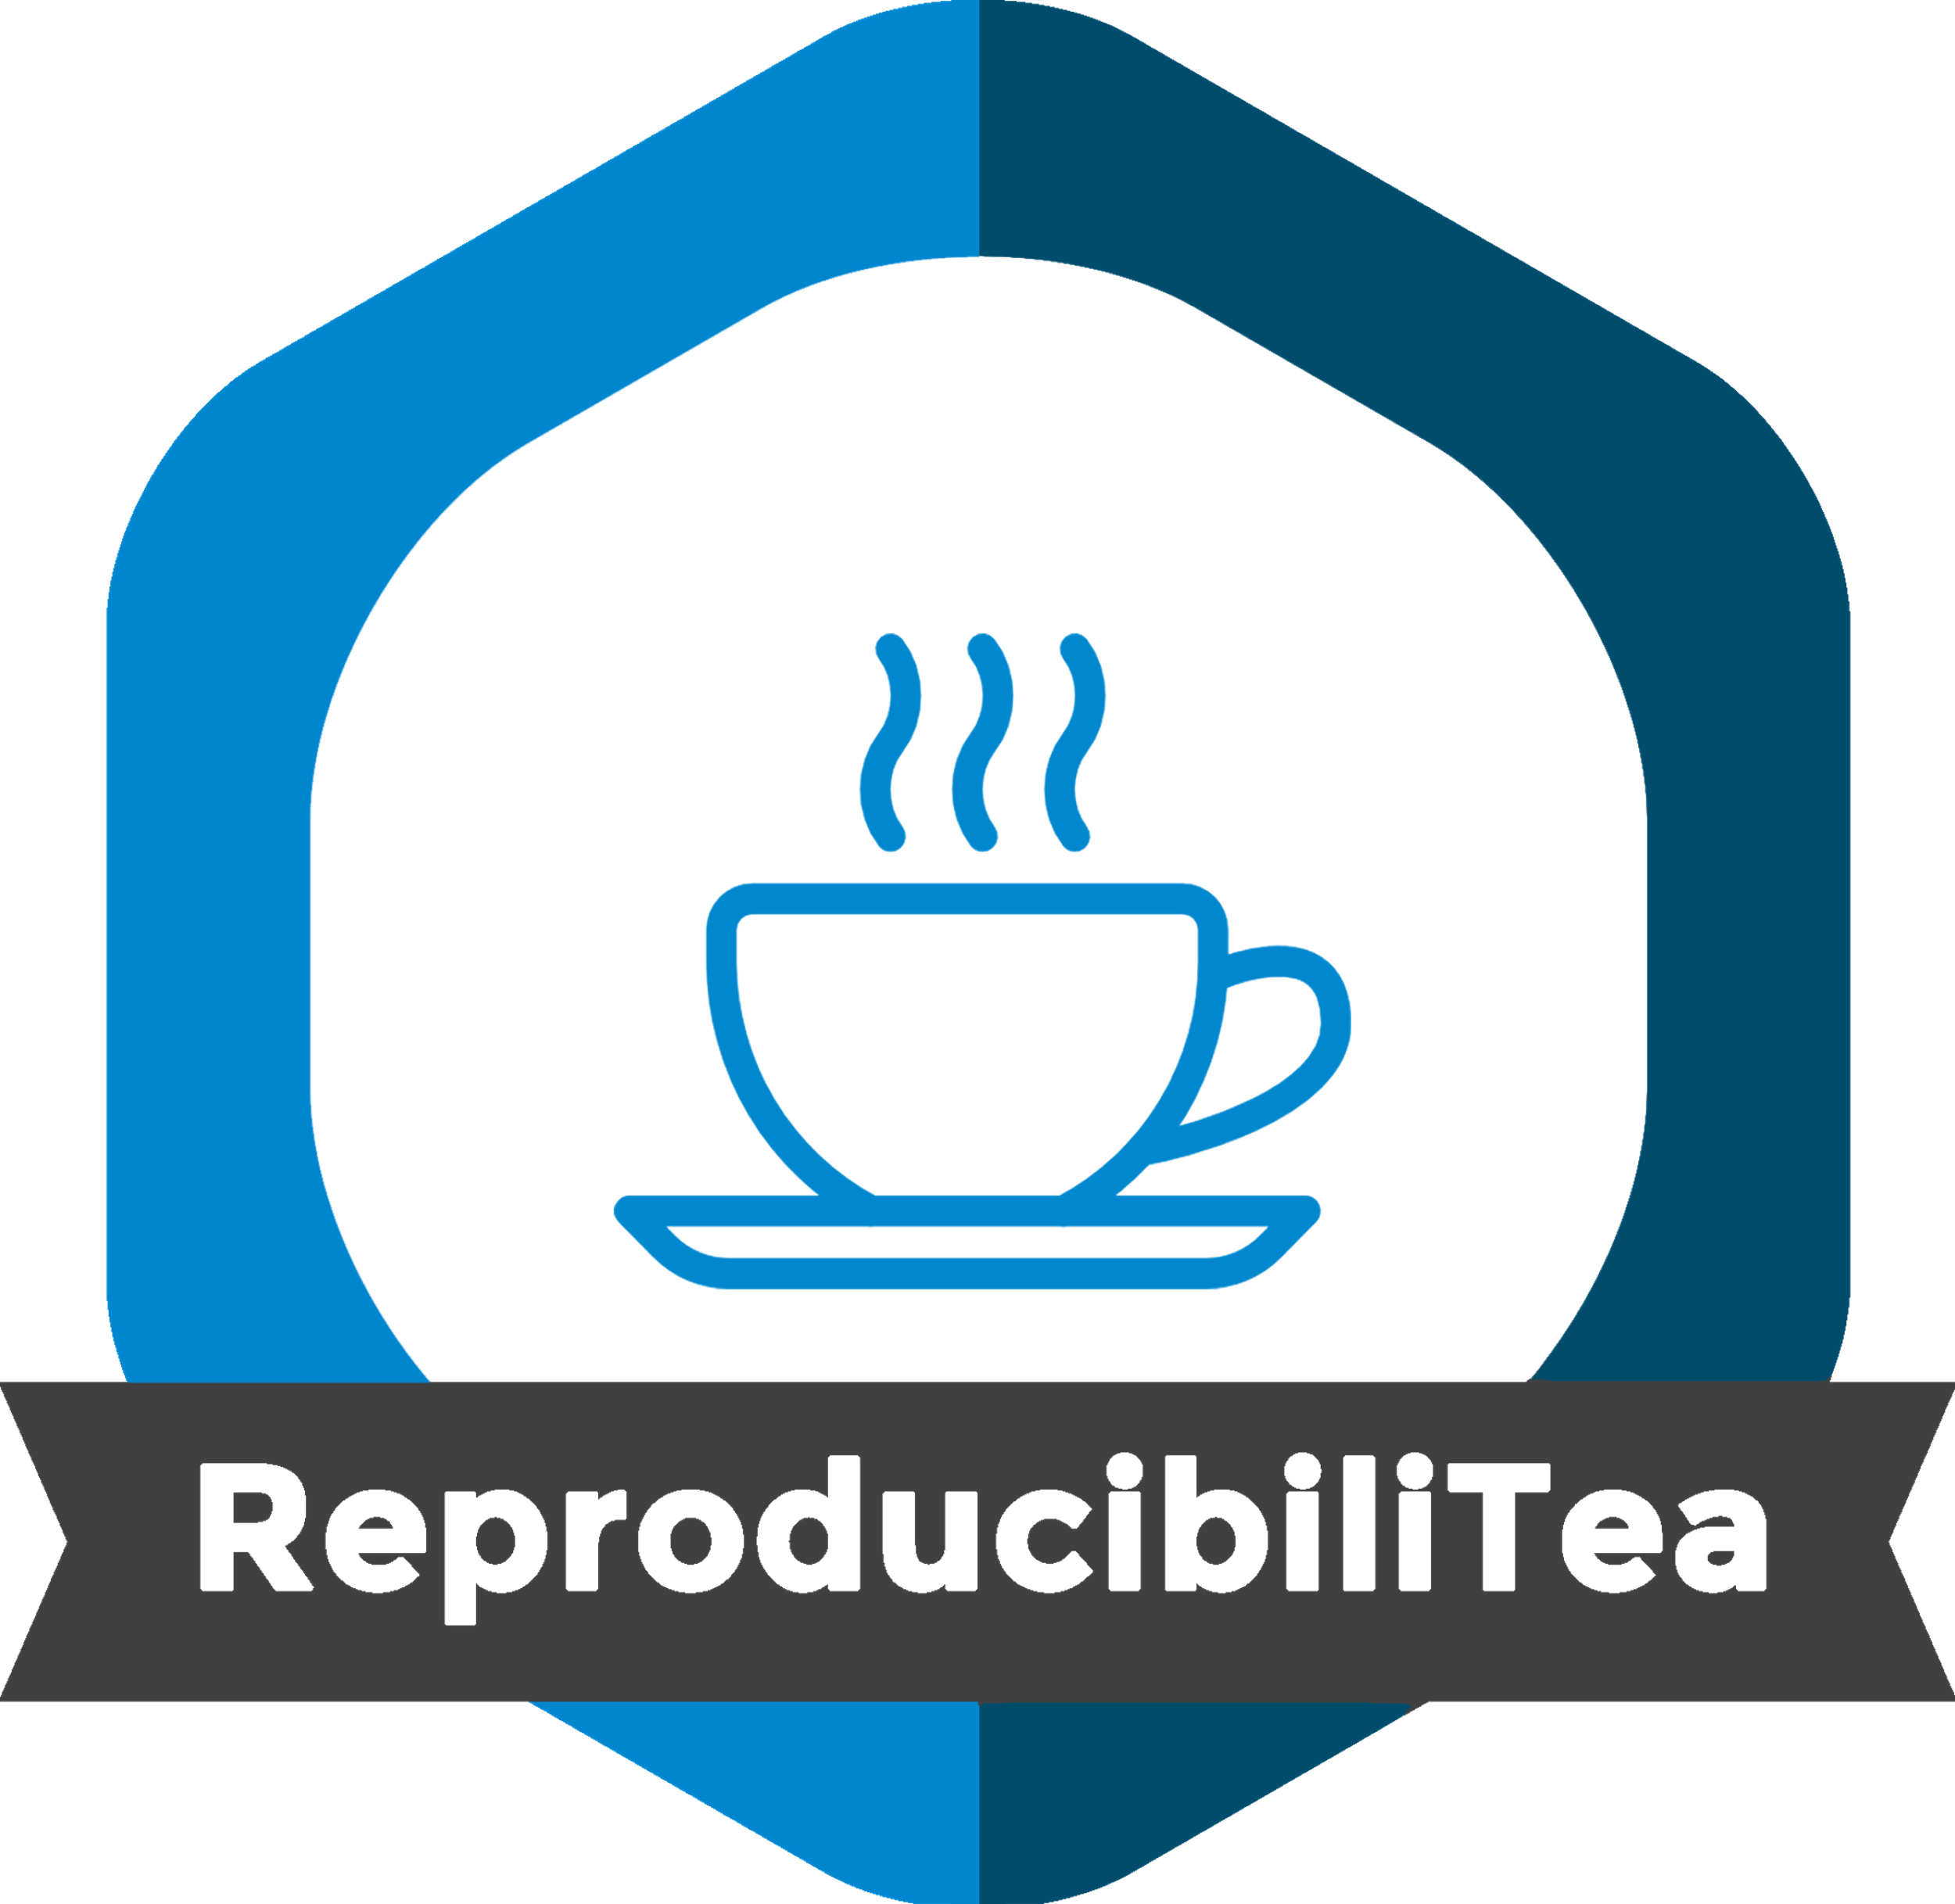
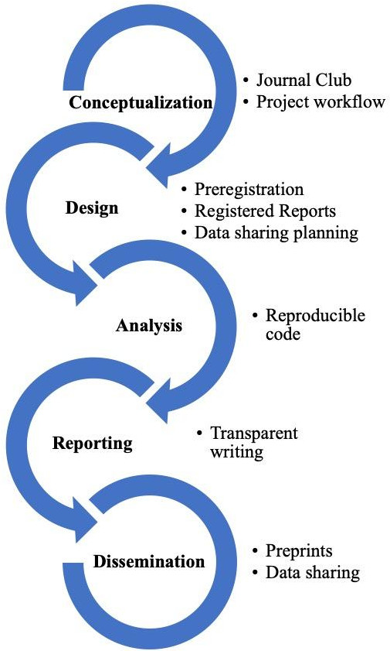
Where do I start?
Open Science is not “all or nothing”
These are research skills that take time to develop!
Some easy Open Science practices to adopt:
Post free copies of published articles / deposit preprints of all manuscripts
Publish in open access venues
Publicly share data and materials
Preregister studies
Kathawalla, U. K., Silverstein, P., & Syed, M. (2021). Easing into open science: A guide for graduate students and their advisors. Collabra: Psychology, 7(1).
McKiernan, E. C., Bourne, P. E., Brown, C. T., Buck, S., Kenall, A., Lin, J., ... & Yarkoni, T. (2016). Point of view: How open science helps researchers succeed. eLife, 5, e16800.

Slide 39
Personal benefits of Open Science
Improve the quality and reliability of your scientific research
For example, preregistrations prompt theory development, justifications of sample sizes and analyses, and statistical power considerations to protect against researcher bias
Increases the impact of your scientific research
Increase reviewers’ quality of feedback if they reproduce your results and analyses
Increase citations from re-analysis and re-use of open datasets
Can become part of your academic brand
Increasingly considered in grants and job applications
Markowetz, F. (2015). Five selfish reasons to work reproducibly. Genome biology, 16(1), 1-4. Piwowar, H. A., & Vision, T. J. (2013). Data reuse and the open data citation advantage. PeerJ, 1, e175.

Slide 40
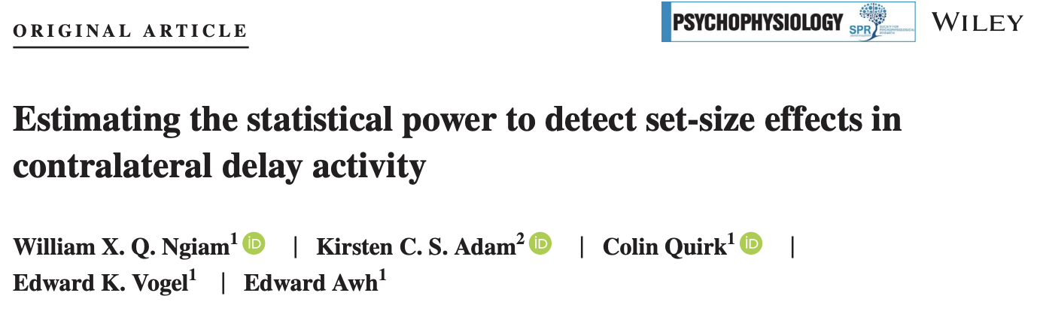
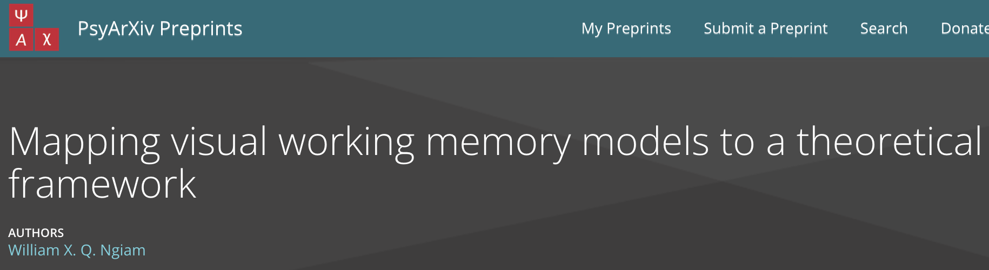
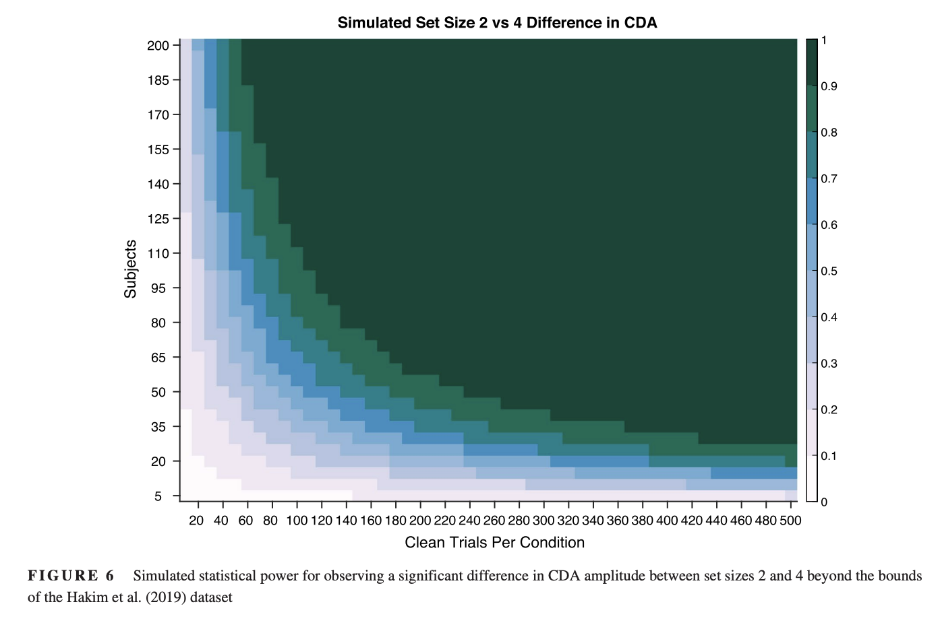
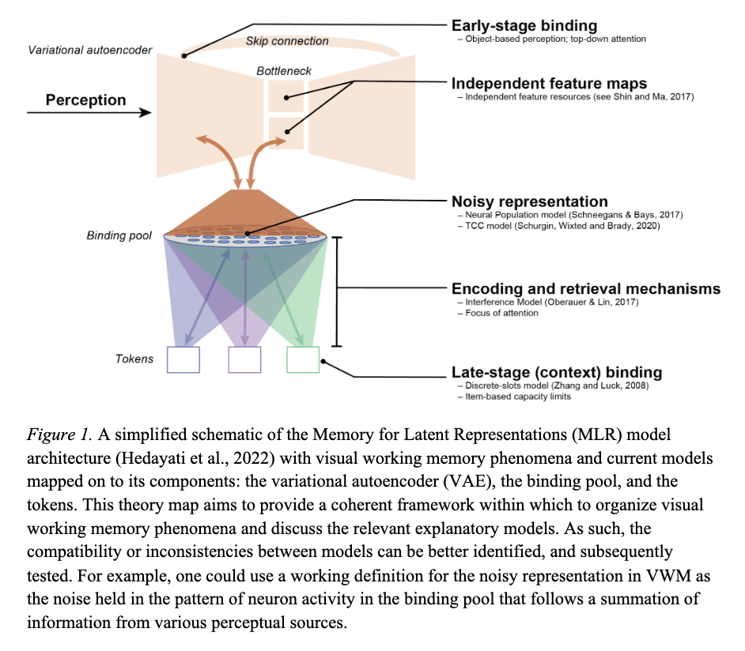
It’s not either/or – your goals can include improving science while conducting empirical research.

Slide 41
The Open Science movement
“An umbrella term used to refer to the concepts of openness, transparency, rigor, reproducibility, replicability, and accumulation of knowledge, which are considered fundamental features of science” (Crüwell et al., 2018)
A rapidly growing and evolving movement that has had (and continues to have) a long-lasting effect on how science is being done!
Right now, it is missing the community efforts that bolster cultural change
Crüwell, S., van Doorn, J., Etz, A., Makel, M. C., Moshontz, H., Niebaum, J. C., Orben, A., Parsons, S., & Schulte-Mecklenbeck, M. (2018). 7 Easy Steps to Open Science: An Annotated Reading List. https://doi.org/10.31234/osf.io/cfzyx
Notes:
mention credibility revolution

Slide 42
The Open Science movement
There are a lot of ideas and initiatives in the reform movement – too many to list:
Experiment design/collaboration: AsPredicted, ManyLabs, Psychological Science Accelerator…
Data and Code: Open Science Framework, OpenNeuro, BIDS…
Publishing: The Unjournal, ASAPBio, DORA, CRediT
Education: FORRT, Repro4Everyone, The Carpentries
Global and National Projects: OSIRIS, Community4Rigor, ABRIR, UKRN and other national RNs
Perhaps not a coherent or cohesive movement in improving science
Not too many of these initiatives have the next-generation of scientists as their direct focus
Notes:
mention credibility revolution

Slide 43
The Open Science movement
A lot of the listed initiatives run on volunteer efforts and energy.
The uptake of (or discussion around) open research practices is not yet normed across the sciences.
These initiatives can be supercharged through community building efforts – only by bringing attention to the right practices and encouraging cultural change, will these reforms take hold.
Notes:
mention credibility revolution

Slide 44
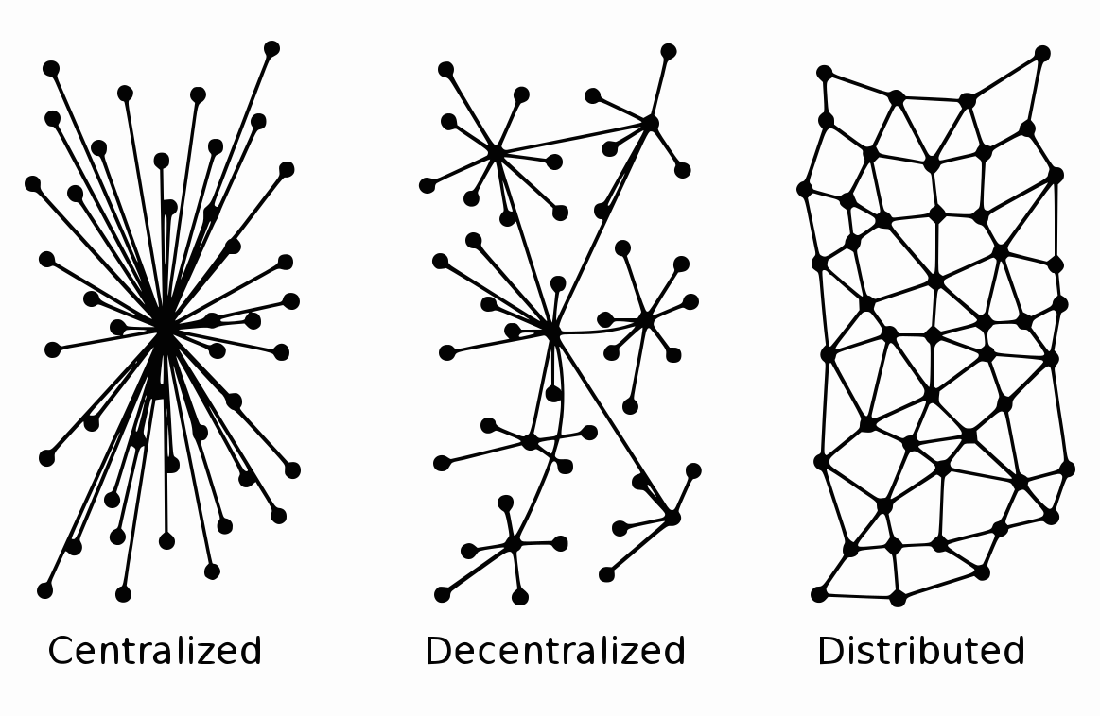
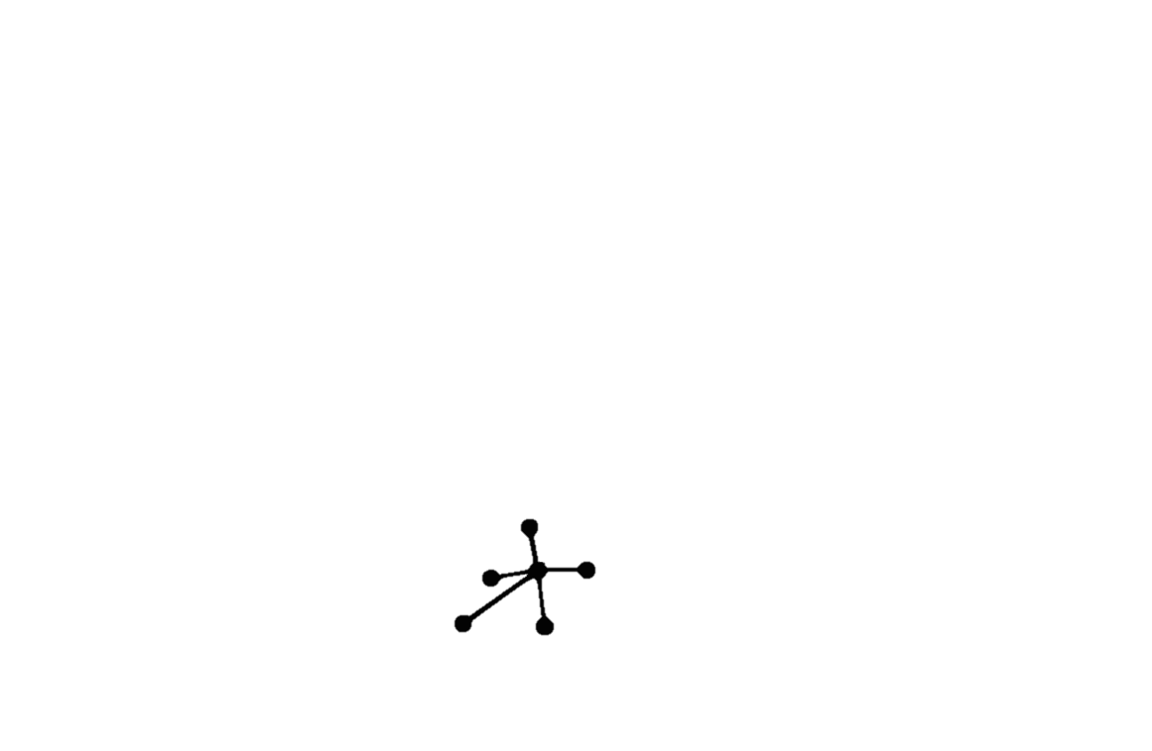

Slide 45
The Open Science movement
A lot of the listed initiatives run on volunteer efforts and energy.
Many open research practices are not yet normed across the sciences.
These initiatives can be supercharged through community building efforts – only by bringing attention to the right practices and encouraging cultural change, will these reforms take hold.
It is my firm belief that the focus should be on the next-generation of scientists – the ones who are inheriting scientific / academic structures and can be the ones that enact change!
Notes:
mention credibility revolution

Slide 46
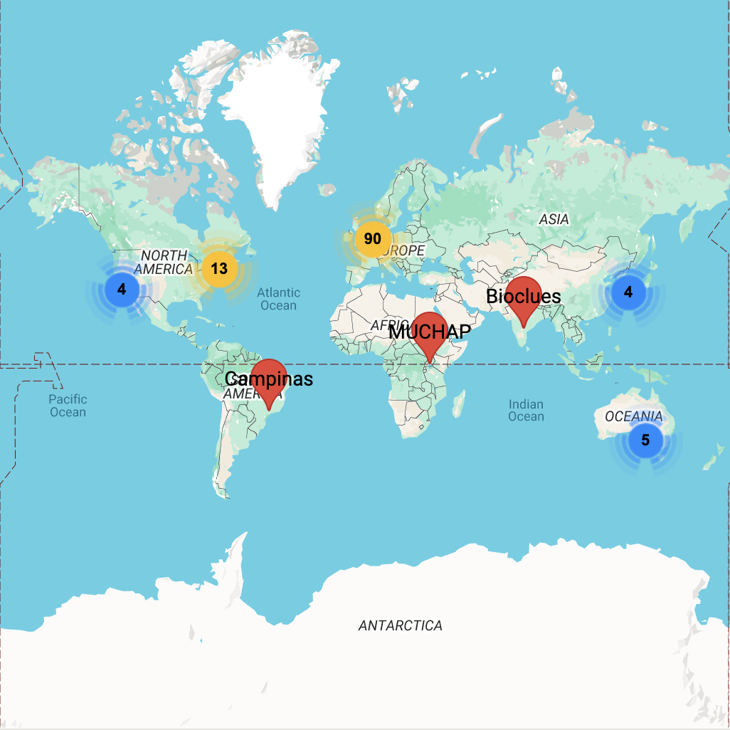
Early-career researchers leading the way with ReproducibiliTea
An initiative founded by early-career researchers in 2018 that now spans 119 institutions across 29 countries
Creating open scholarship communities at research institutions, especially empowering early-career researchers
Check out https://reproducibilitea.org/

Slide 47
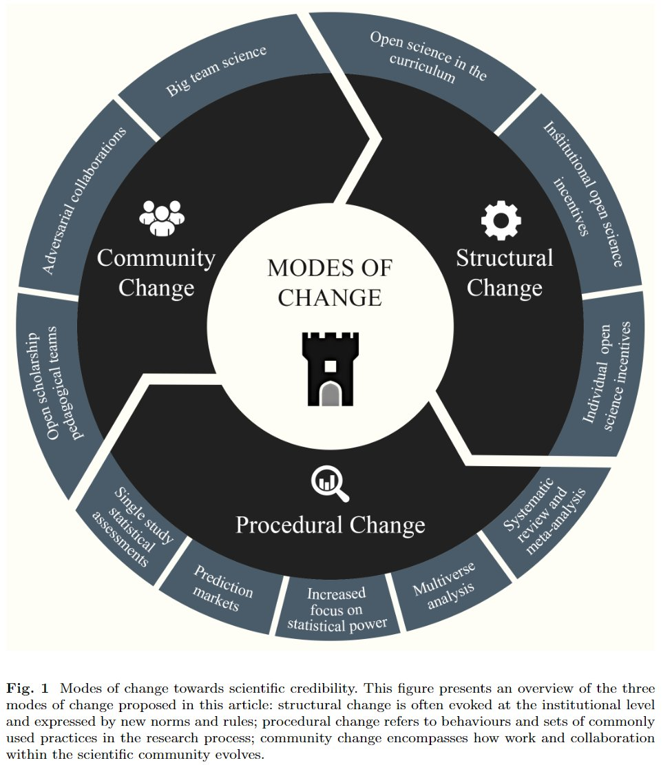
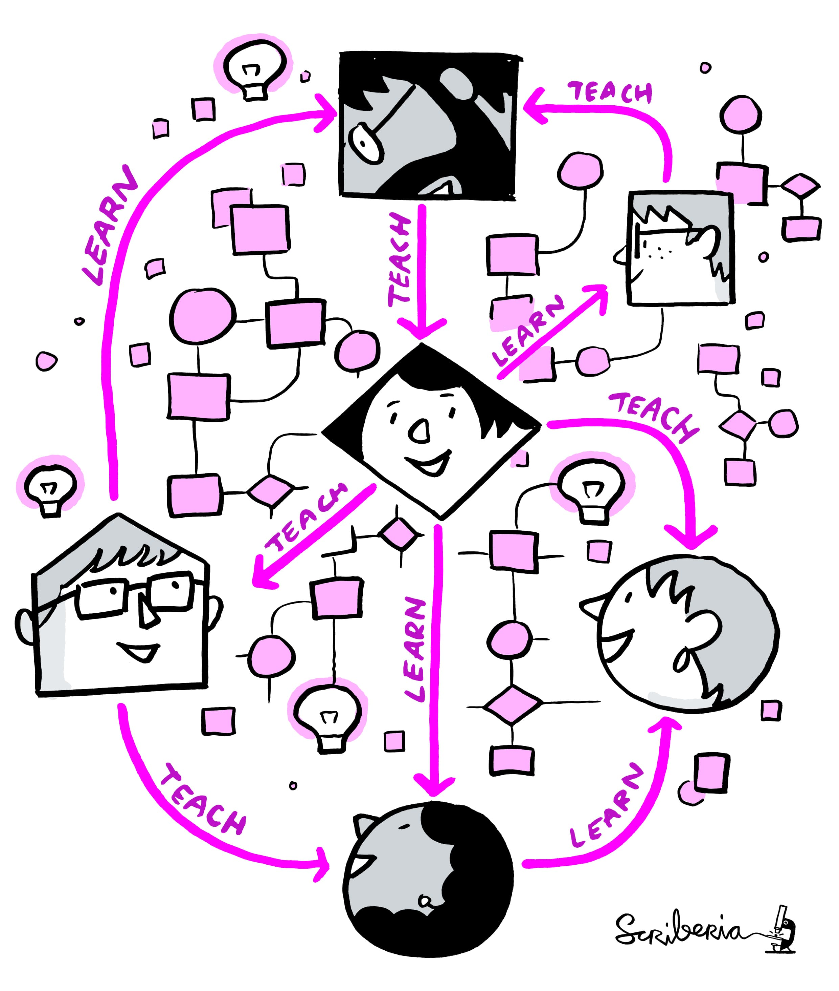

Korbmacher, M., Azevedo, F., Pennington, C., Hartmann, H., Pownall, M., Schmidt, K., ... & Evans, T. (2023). The replication crisis has led to positive structural, procedural, and community changes. Communications Psychology.
Communication network for sharing, learning and teaching. The Turing Way project illustration by Scriberia. Used under a CC-BY 4.0 licence. DOI: 10.5281/zenodo.3332807.

Slide 48
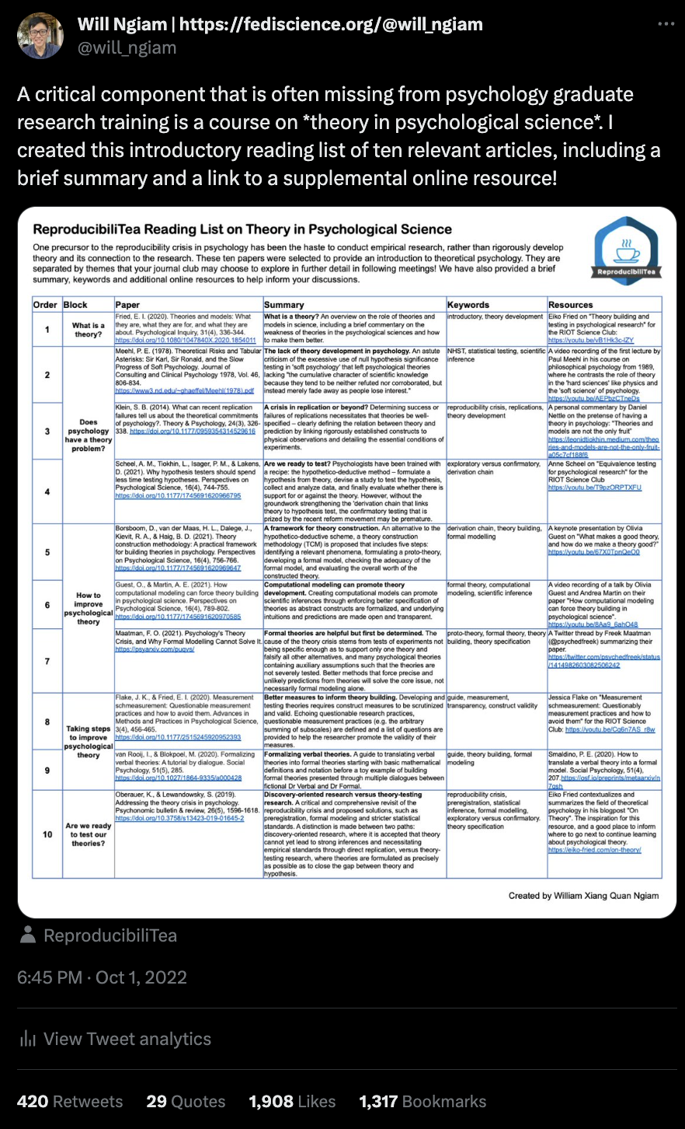
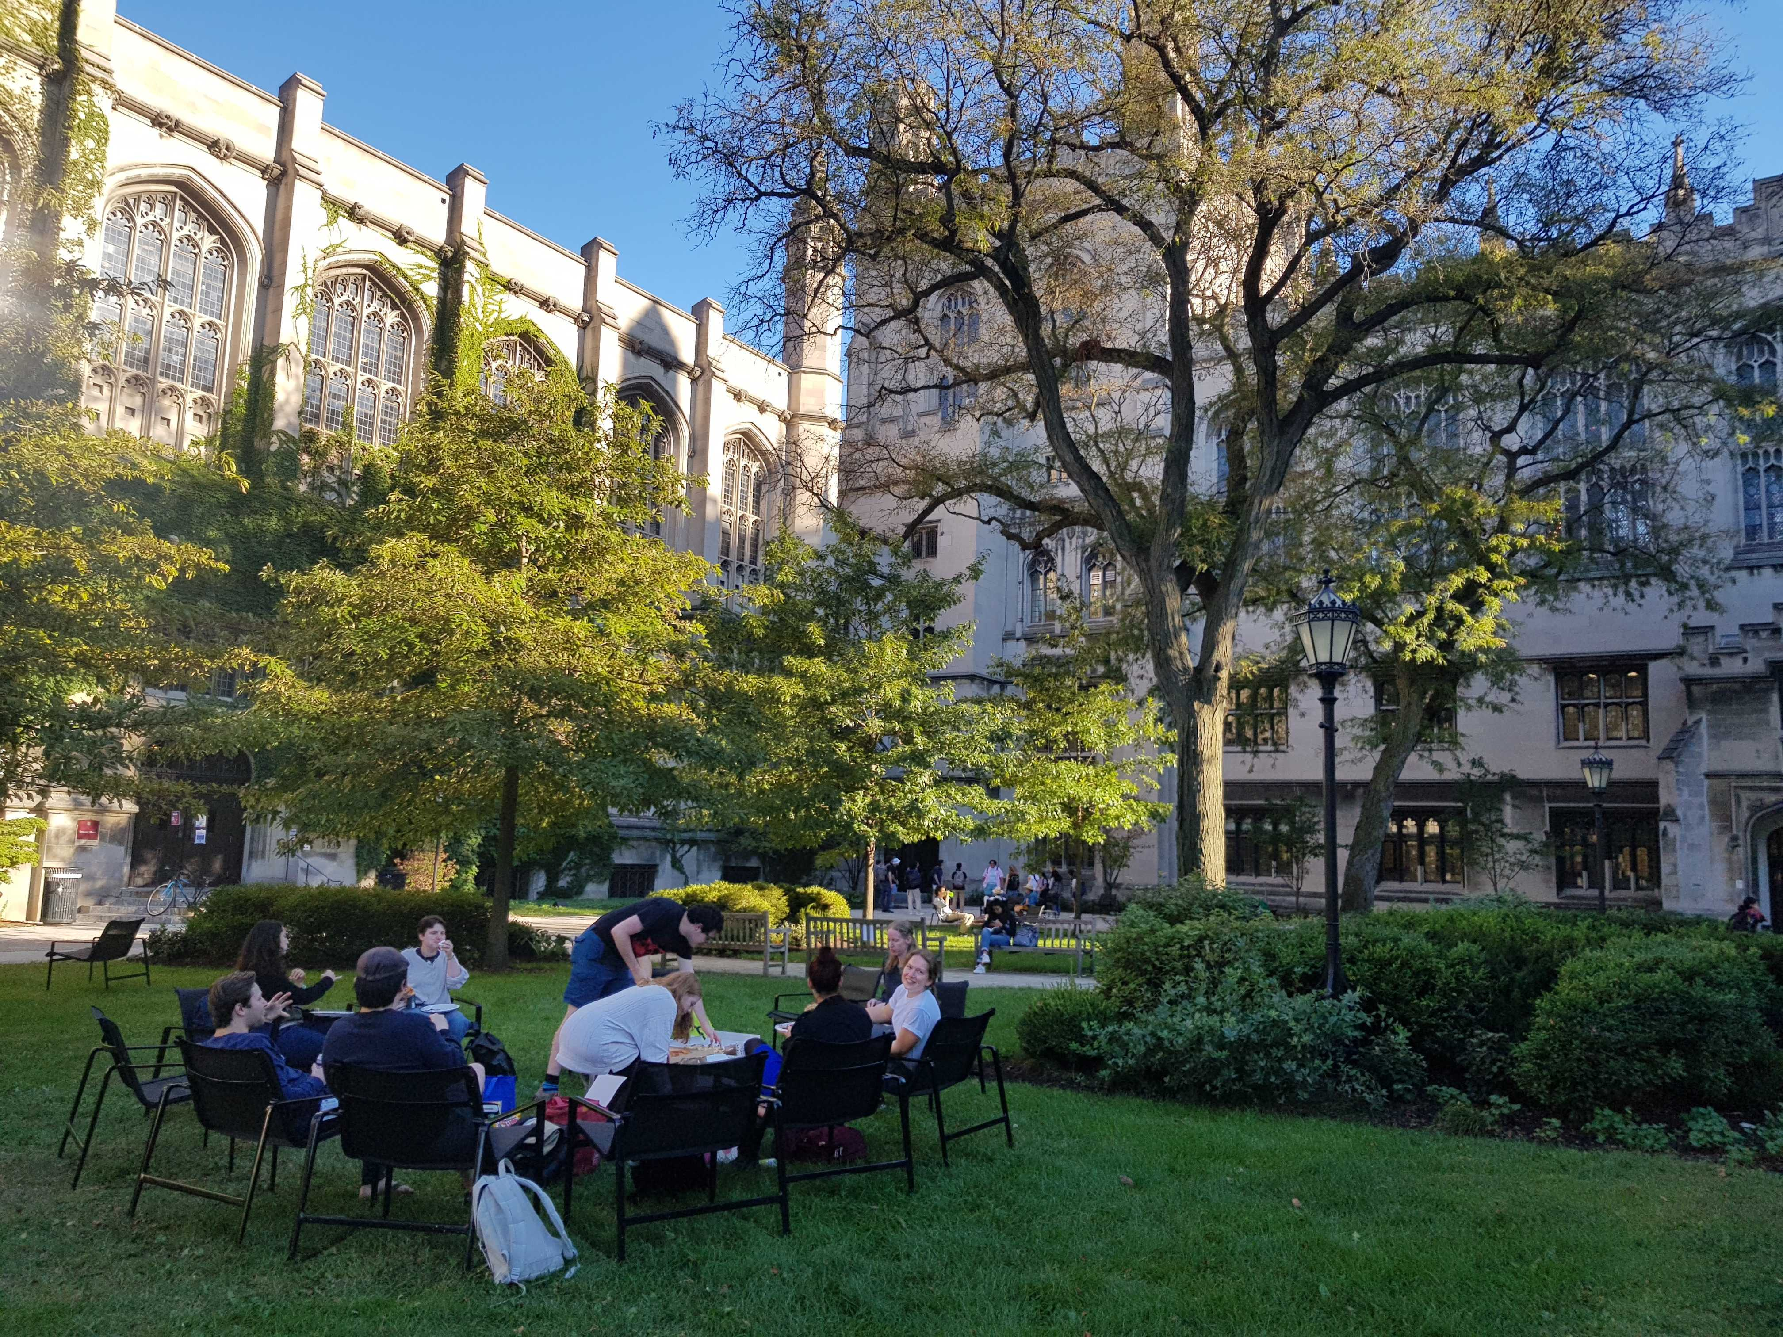
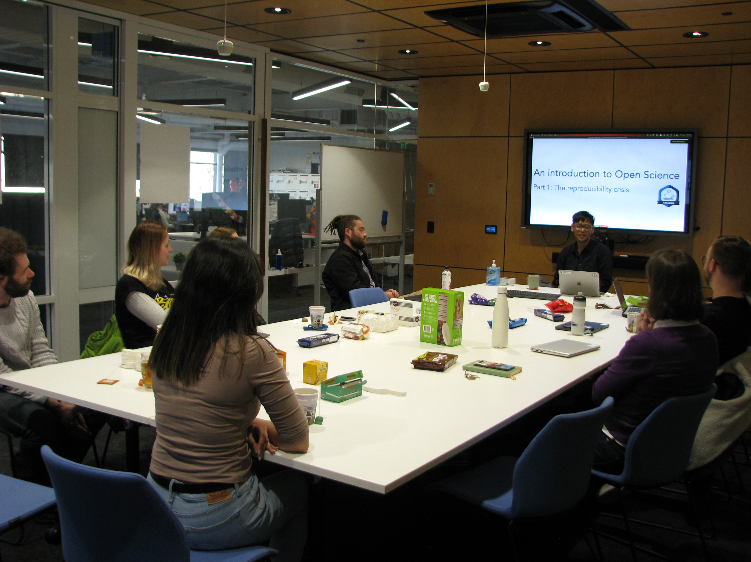
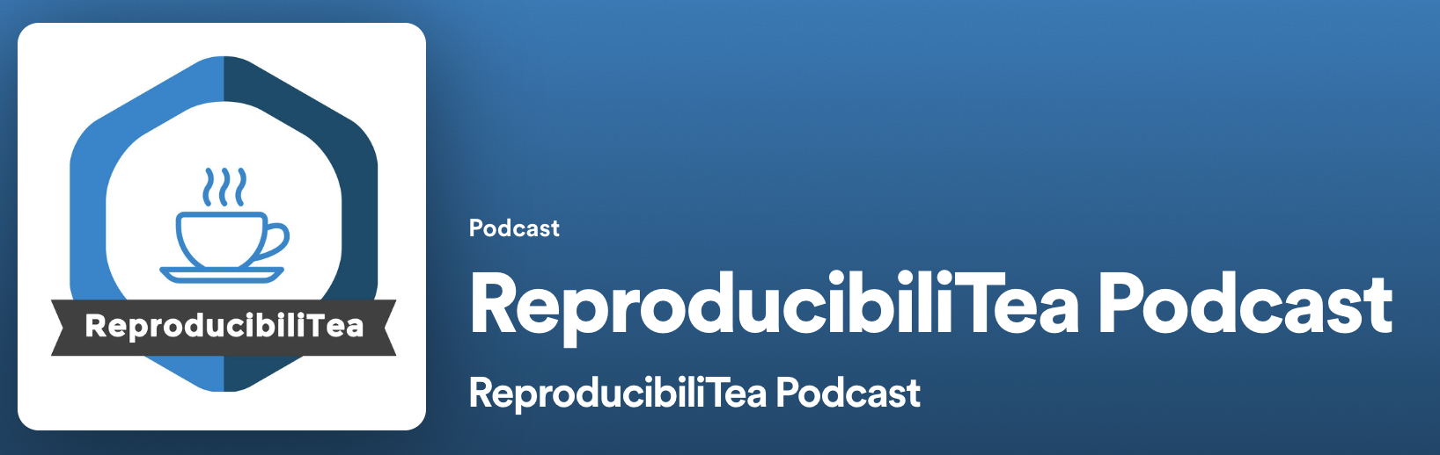
Started a ReproducibiliTea journal club at the University of Chicago and the University of Adelaide
Joined the steering committee of the global organization

Slide 49
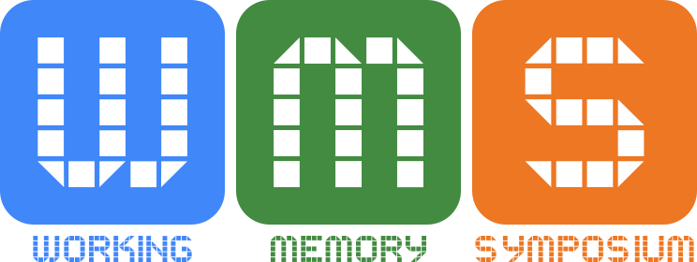
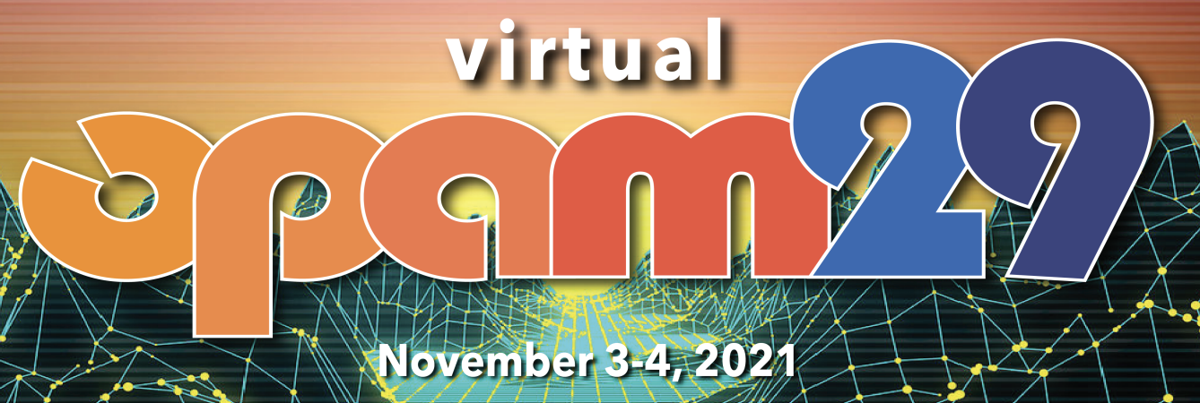
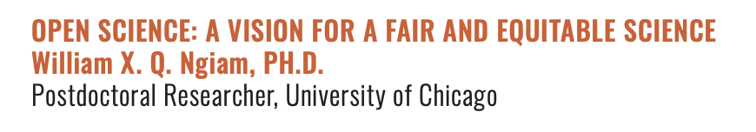
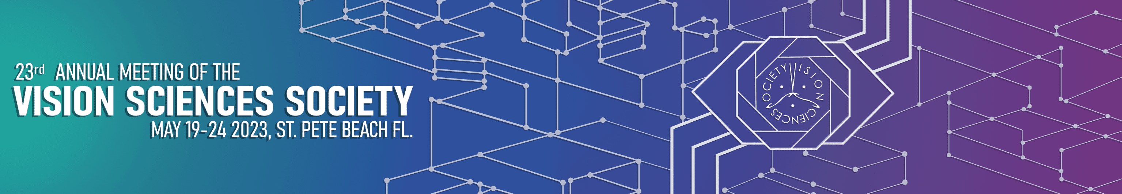




Organized a free virtual conference for early-career researchers to present their work when in-person conferences shut down due to the pandemic

Slide 50





Slide 51



The credibility revolution in science can only succeed if we take action together.
Dr William Xiang Quan Ngiam williamngiam.github.io william.ngiam@adelaide.edu.au

